Slide 2

ReferMe
Trust the people you trust
Notes:
Hi. We are ReferMe.

Slide 3




Management Team
Hanna Yanglou: Engineer, Sales
Alan Larson: Computer Engineer
Ava Zhang:
Finance
Trent Anderson:
Engineer, Real Estate Expert
Notes:
We are group of engineering and business students from the University of British Columbia.

Slide 4

Team Expert
TRENT ANDERSON
Civil Engineering Graduate and Experience Technologist
RE/MAX, REALTOR ASSISTANT, CALGARY – 2014/2015
Notes:
One of our Teammates, Trent Anderson, comes from a family of realtors. He gave an insider tip on the two big needs clients and paperwork, the legal documents realtors had to lug around

Slide 5


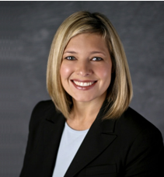

Tinder for Realtors
Realtor
Client
Notes:
We developed ideas, Our Tinder-like App. And hypothesized that both realtors and clients cared about the type of person they worked.
Our other idea was a black box kind of machine, that would organize and scan legal documents, synced to the realtor’s calendar.

Slide 6
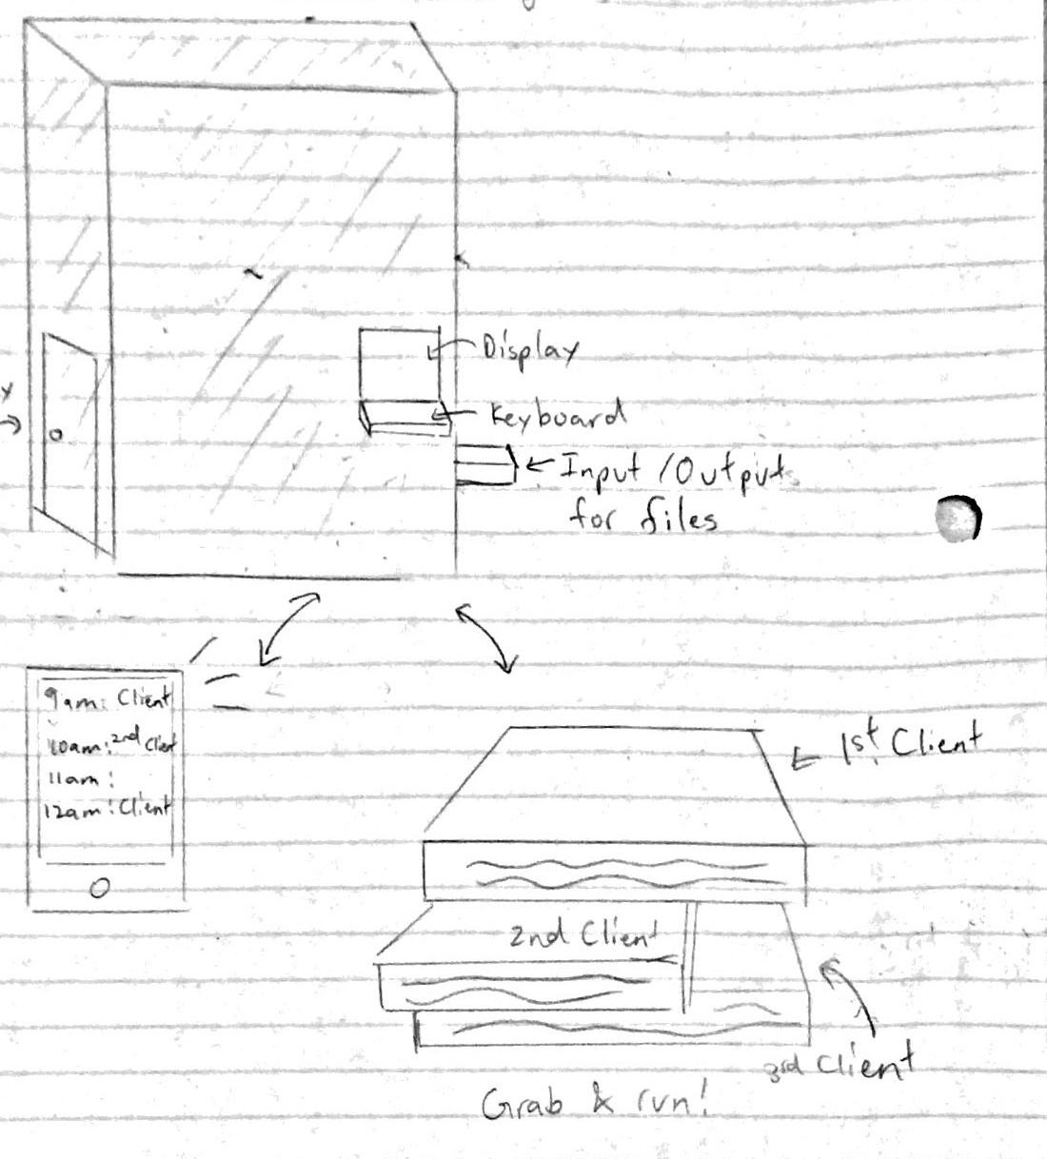
Tinder for Realtors vs. Filing Solution
Realtor
Client
Notes:
We developed ideas, Our Tinder-like App. And hypothesized that both realtors and clients cared about the type of person they worked.
Our other idea was a black box kind of machine, that would organize and scan legal documents, synced to the realtor’s calendar.

Slide 7
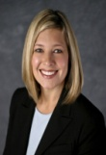





Interviewed:
7 realtors
12 homebuyers
Notes:
We took to the streets to talk to realtors and clients

Slide 8
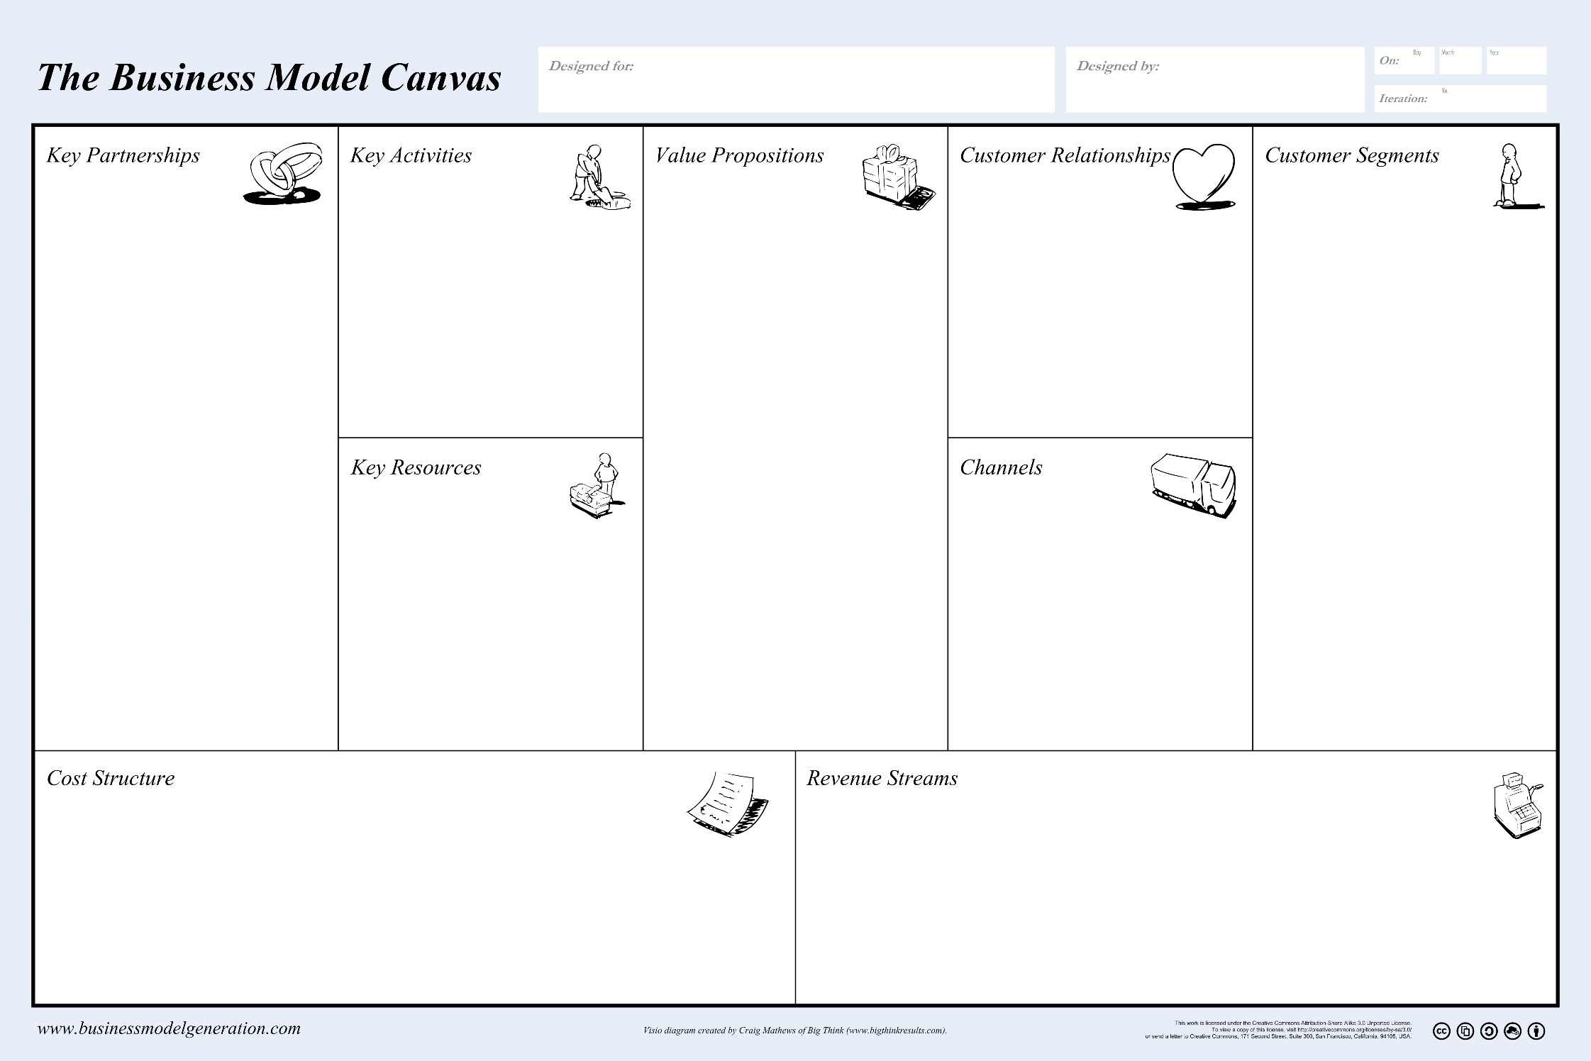


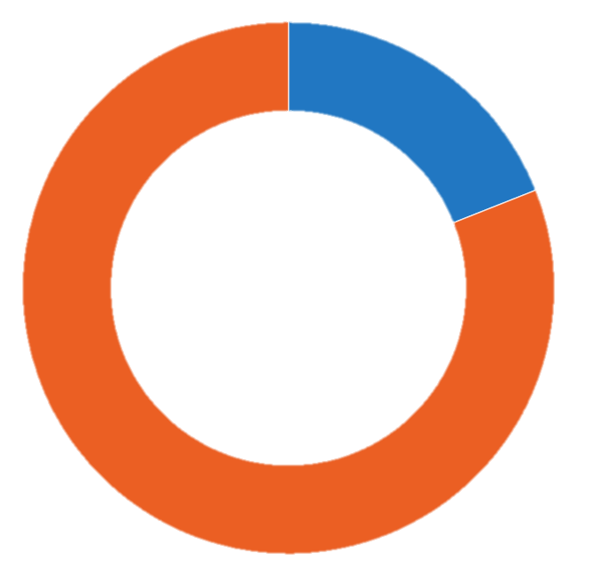
Realtors: Have Trouble with Files
Pain with Paperwork
Yes
No
19%
81%
Notes:
In our initial contact. we discovered immediately that Realtors that didn’t really care about paperwork.
(15/29 said Client Base
9/29 said Paperwork)

Slide 9

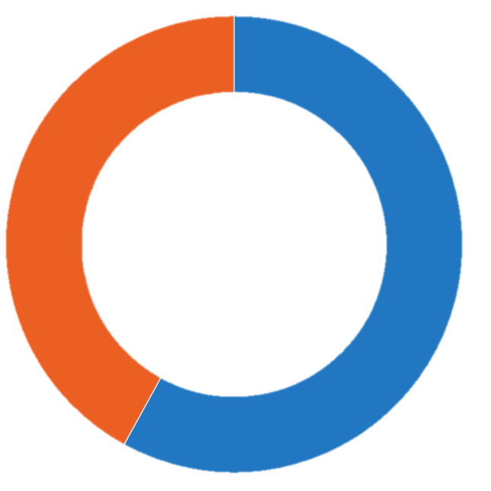
Realtors: Have Trouble Finding a Client
[The] hardest part is finding new business.
“
Pain in Establishing Client Base
Yes
58%
No
42%
Notes:
We did find that the top pain of the realtors we talked to was finding new clients. This was constantly on their minds during their work day.
(15/29 said Client Base
9/29 said Paperwork)

Slide 10
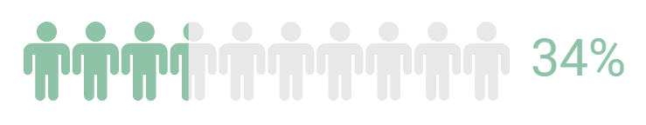
Realtors: Care About the Type of Client
Notes:
We also asked them if they had ever walked away from a client because of their personality or business style and we found that … not really. Business is business . So back to the drawing board there.

Slide 11


Realtors: Care About Personal Contact
I only meet clients in person to start business. If they don’t have time to meet in person, they are not worth my time.
“
72%
Not satisfied with web leads
56%
Want more personal contact
Notes:
However, we did discover realtors weren’t happy with the impersonal technology today. They valued trust. So we pivoted.

Slide 12


Pivot: Realtors Use the Referral Network
79%
Realtors use referrals as a primary way to get clients
70%
Clients got their realtor from a friend or family member
Notes:
The real estate industry, we realized , was driven by the referral network. But there was nothing like that online…

Slide 13











Product Brief
ReferMe
Existing
www.ReferMe.ca/website
reviews
Of past &
present clients
Connects
through
Social
networks
Notes:
ReferMe is website that uses existing testimonials of realtors from their current clients, links it to the social network of new clients so realtors can find better leads and clients can find a better realtor. There is a huge demand for such a product and nothing quite like ReferMe. Let me explain how we got here.

Slide 14
ReferMe
Notes:
We put this into our Business Model Canvas and decided to test if this met the needs of realtors and clients today.

Slide 15

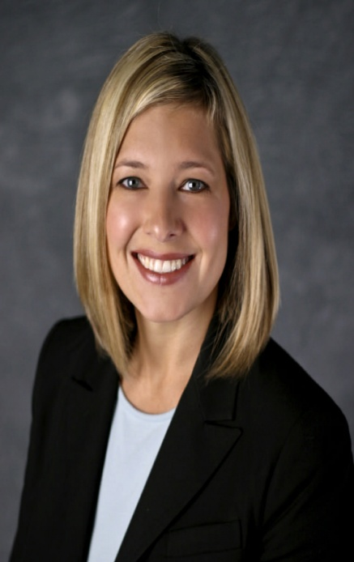
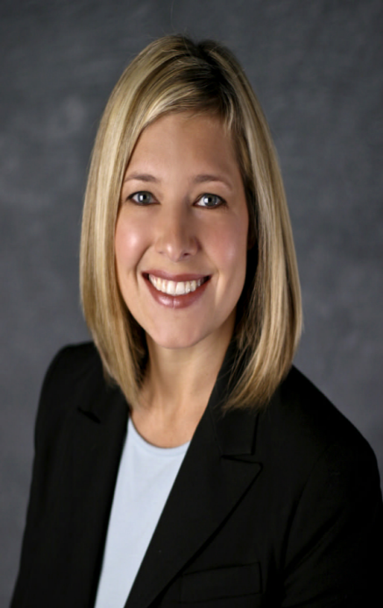



Hypothesis: Customer Personas
Realtor
Client (home buyer/seller)
Hard time find clients
Trust their friends to refer them a realtor
Care about the people they work with
Care about the realtor they work with
Will use technology if the clients are using it
Use technology for the house search
Target Segment: 20-30 years old
Target segment: 20-30 years old
Notes:
We created our hypothesis of who we thought would use our product and interviewed in 51 clients and 29 realtors

Slide 16
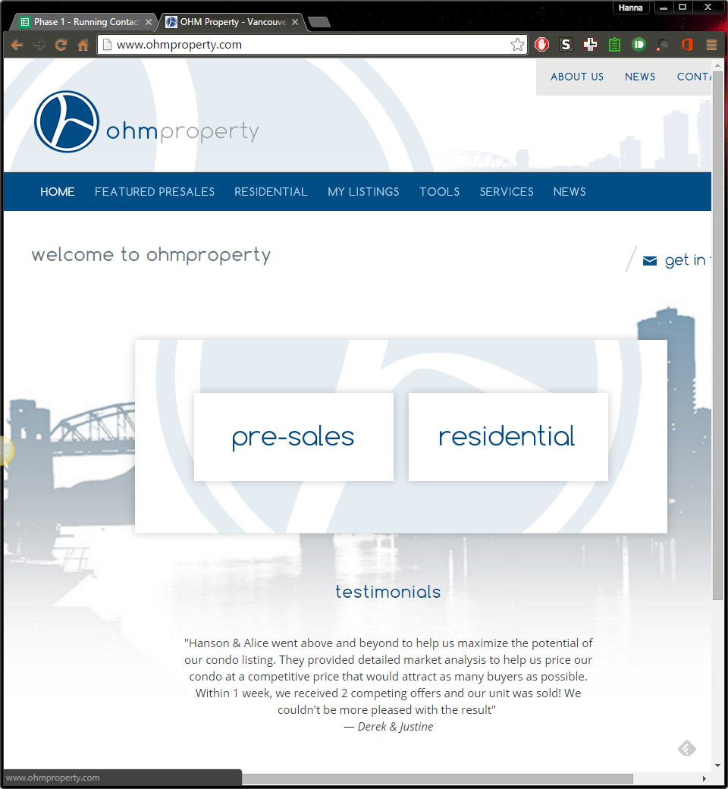


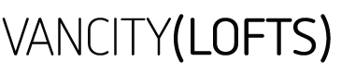




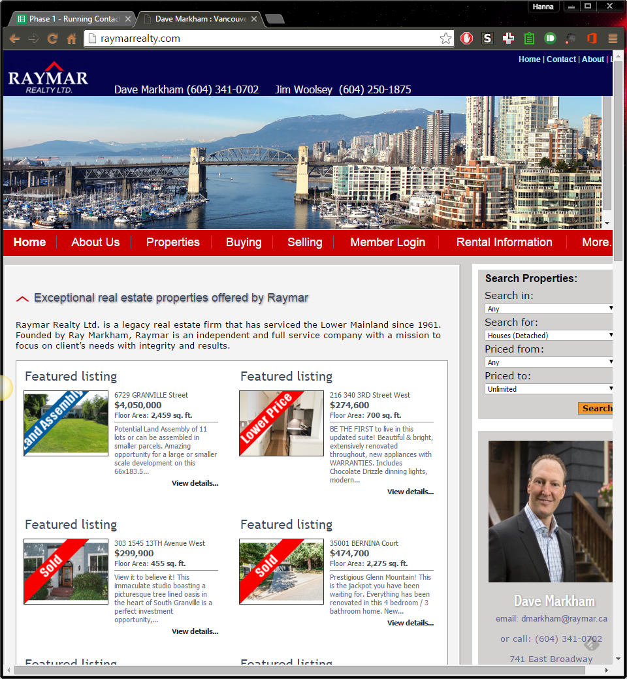
Different Brokerages
Interviewed:
19 realtors
Notes:
These realtors from many different brokerages you see above. We found that…

Slide 17

Realtors: Are Tech Savvy
Technology is huge.
You either learn or get left behind
“
77%
Say technology is indispensable
Notes:
The industry is so fast-paced and all aged realtors use technology. Three out of four realtors are on Facebook and LinkedIn to build relationships.
(77% of realtors are on Facebook and 75% are on LinkedIn, and the main reasons realtors are on social media are to build relationships (70%), create visibility and marketing (64%) and advertise (51%). )

Slide 18
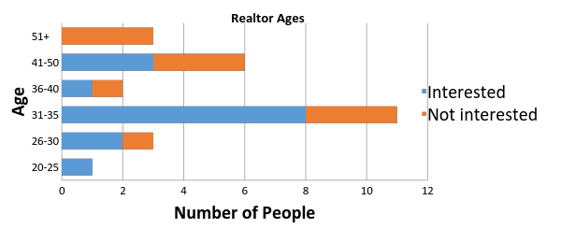
Realtors: 20-30 years old
Notes:
We thought young realtors were the most interested in our product but our data shows realtors of all ages were interested. Because realtors start in very many different stages of life, a better indicator was how experienced they were in the industry.

Slide 19

Realtors: Less Experienced in Industry
Interested:
8 Years in Industry
Notes:
The average industry time of realtors is about 12 years. Those who expressed interest in our product had around 8 years of experience. This is because newer realtors are still establishing their client base and are interested in our solution.

Slide 20
Realtors: Are Tech Savvy
What’s going to be interesting is how technology shapes this industry.
“
Notes:
We’ve have heard realtors talk about the upcoming “Millennials” and how different they think and search for a home. They recognize the importance of new technology to help their clients. We actually verified this talking to our homebuyers.
(77% of realtors are on Facebook and 75% are on LinkedIn, and the main reasons realtors are on social media are to build relationships (70%), create visibility and marketing (64%) and advertise (51%). )

Slide 21
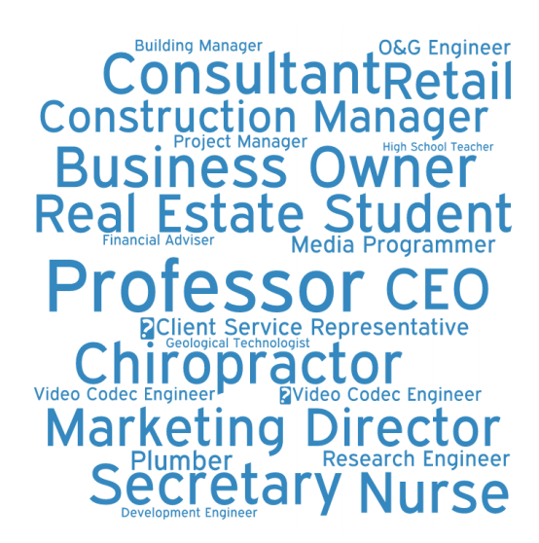
Clients: We Talked To
Interviewed:
37 clients
Notes:
We talked to anyone and everyone who had bought a house. From student to engineers to professors and this is what we found.

Slide 22
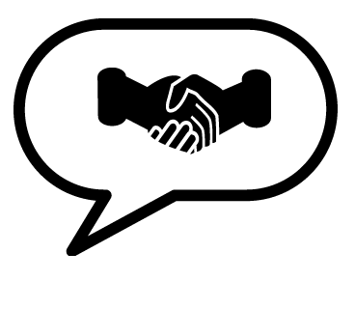
Clients: Have a Criteria for Realtors
96%
Use Realtors
Have a set of requirements for finding a realtor.
Knowledgeable (55%)
Accommodating (43%)
Friendly (41%)
Notes:
almost all of them want someone experienced to help them in this process, and have an idea what type of person they would like to work with

Slide 23
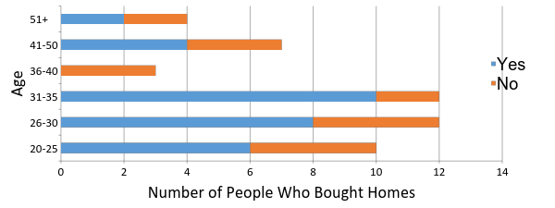
Clients: Use Technology in House Search
Age of Clients vs. Interest in Product
Notes:
We found the clients most interested in our solution were those from 20-35 years old.

Slide 24

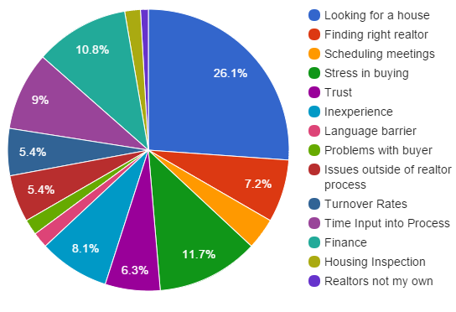
Clients: Can’t Find a Good Realtor
Notes:
Our main problem was that the needs of a client were all over the place. We didn’t know how to zoom in and create a product that could solve all that.

Slide 25
Hypothesis: Customer Personas
Realtor
Client
Talk to their friends about buying a home
Actively seeking clients
Care about the realtor they work with
Not more than 12 years experience in the business
Had bad experience with a realtor
Top 15% of brokerage
20-35 years old
Notes:
Our typical realtor is one like Linda. She is a hardworking realtor of seven years in the industry, and aims to average 40 homes a year (Add: top to 5-10% of brokerage). She has referrals and testimonials in from her previous clients, but it’s not enough, and she’s actively sending out listings and going to events to find new clients.
Jennifer and Toni are a young professional couple in their late 20’s. They have well-paying jobs and savings and they have been talking about buying a house to their circle of friends for a while. However, they worked with a realtor for a month and weren’t comfortable with his flashy, aggressive style. They are not sure what to do and how to find a realtor they can trust.
We expanded our market to 20-35 year old users, and chose to focus on realtors who were 5-10 years in the industry and who were the top 5-10% of their brokerage. This is to make sure we had quality realtors on our site, who already have established testimonials that we can move on to ReferMe. For clients we narrowed our segment to those who have had a bad experience with realtors, which was about 30% of the clients we talked to. These are our early adopters, who we establish the traction we need for normal users to get on our site.

Slide 26
ReferMe
Notes:
And now we were able to finally start our Business Model Canvas, after three pivots and 80 interviews.

Slide 27
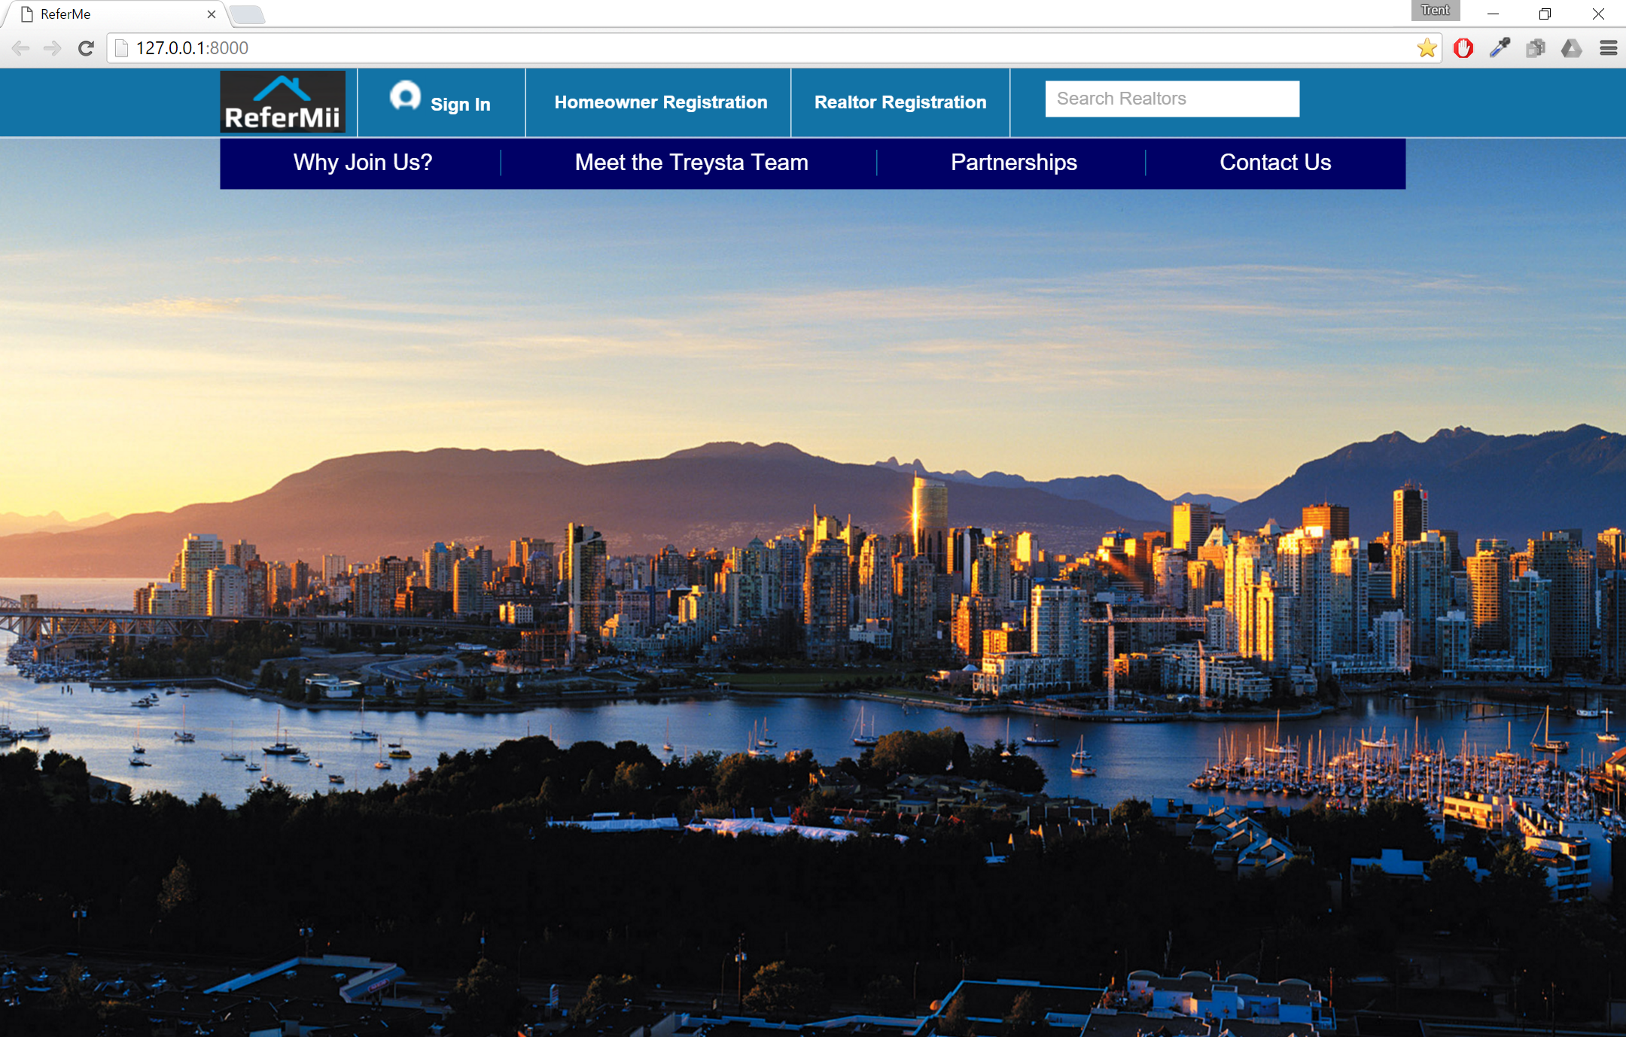
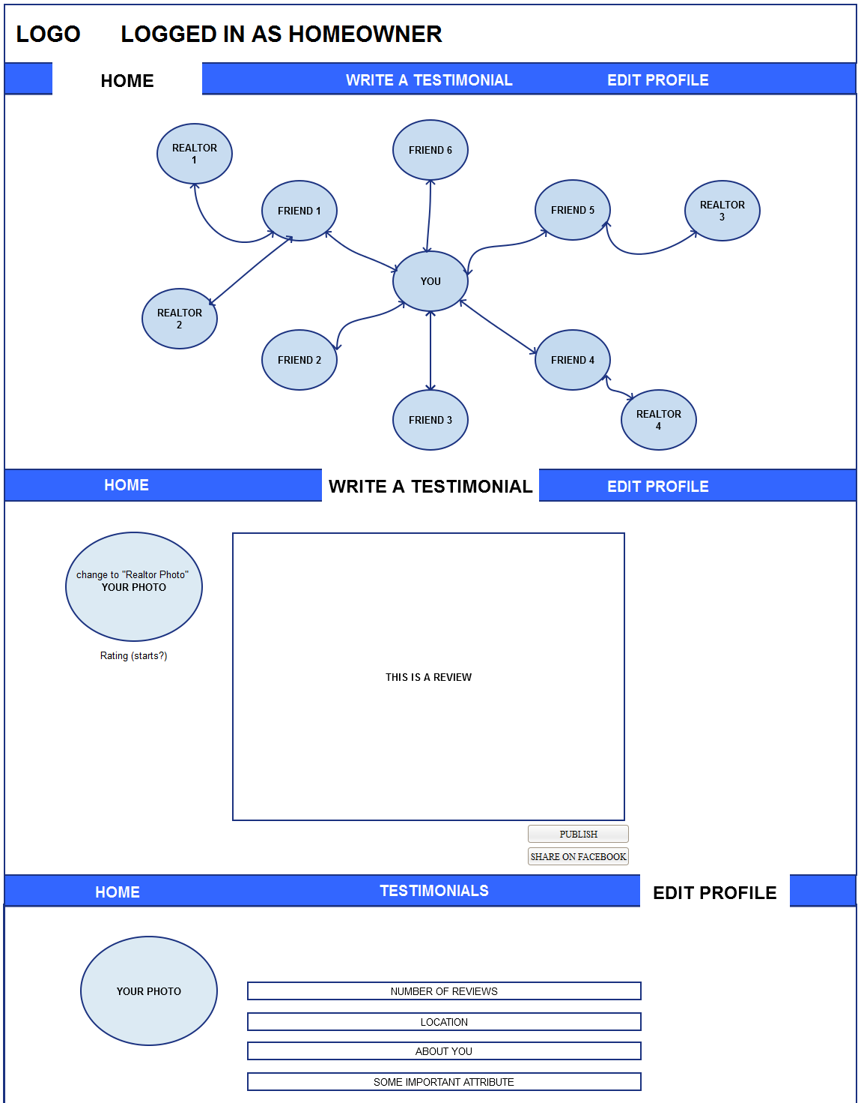
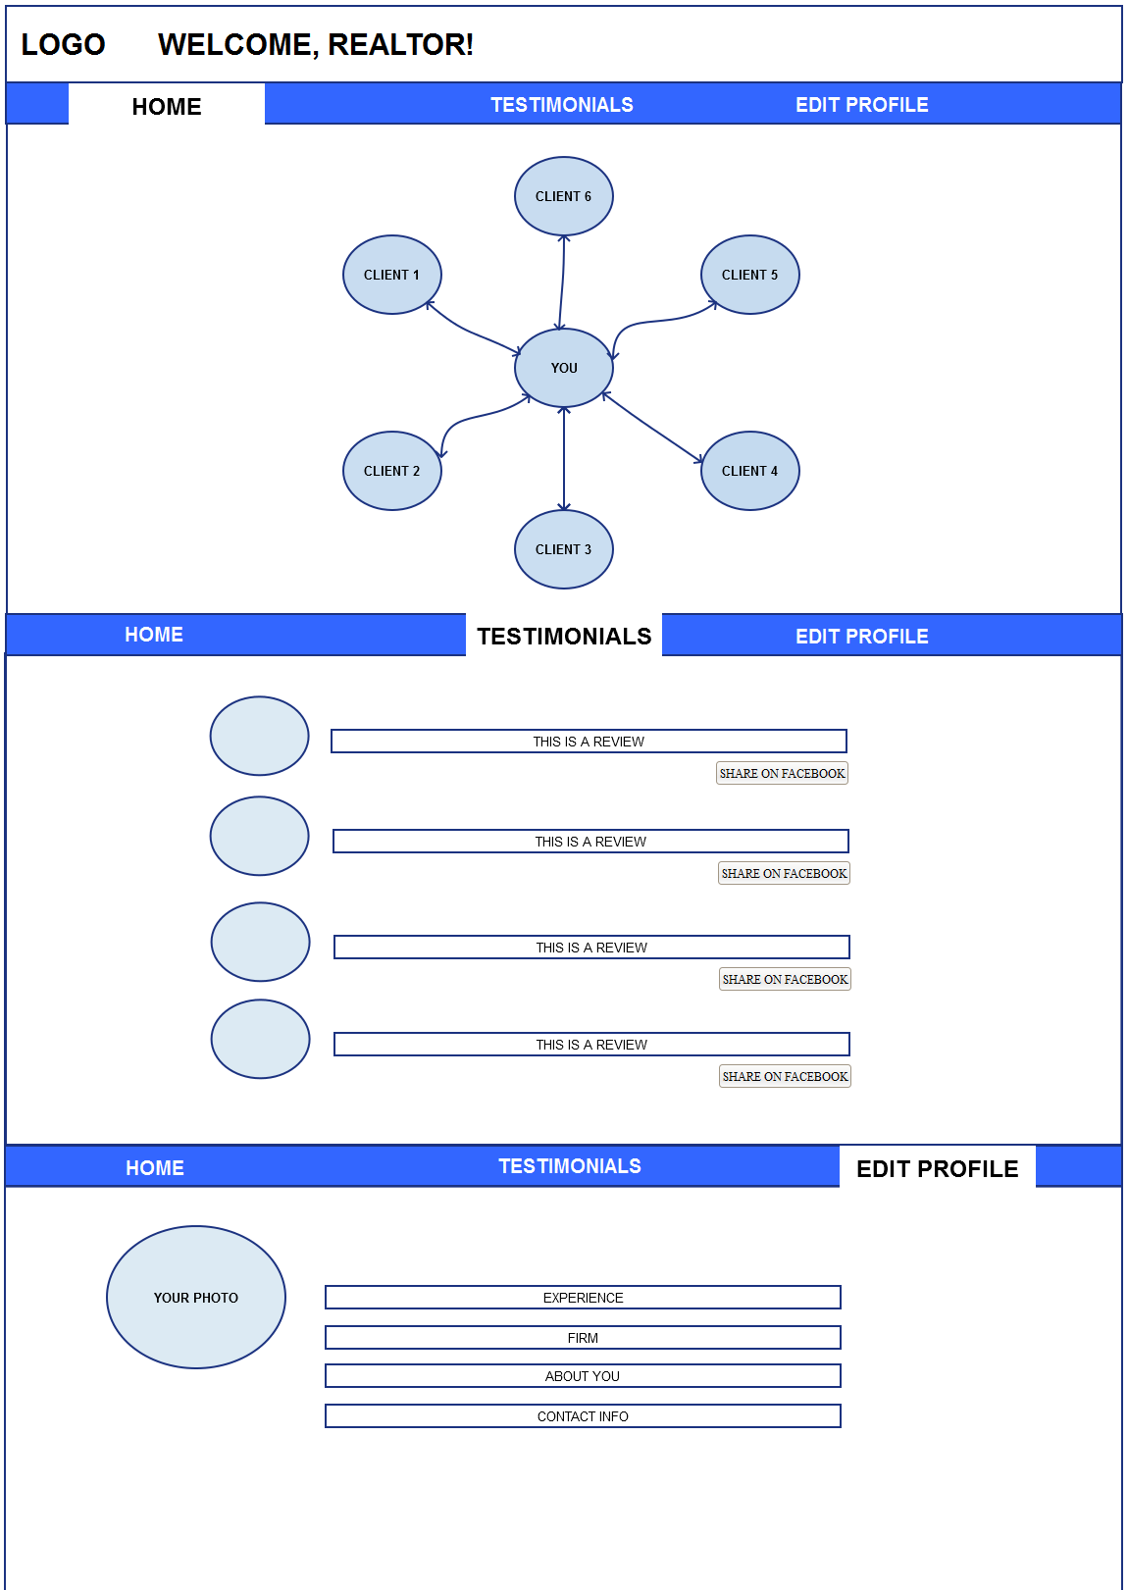
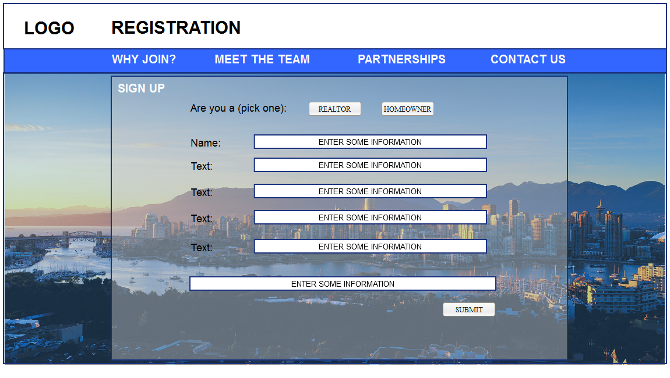
Prototype: Current MVP
Notes:
Our Initial Prototype – Hypothesis: Match the features to customer needs
1st degree testimonials
Rating system
Dashboard
Profile
Premium
Analytics
Client Review Management
Improved Ratings
Advertising

Slide 28
Prototype: Current MVP
Interviewed:
9 realtors
6 homebuyers
Notes:
Our Initial Prototype – Hypothesis: Match the features to customer needs
1st degree testimonials
Rating system
Dashboard
Profile
Premium
Analytics
Client Review Management
Improved Ratings
Advertising

Slide 29


Customer Relationship & Channels
Notes:
Using the Business Model Canvas, we determined the best way to contact and develop customer relationships. One-on-one personal contact and social media. Our channels will be word of mouth , social media and reaching out to spokespeople and industry influences. This is backed by our current stage customer research of how realtors find out about products (from 9 realtors and 3 clients)
1:1 meeting
Social media
WoM

Slide 30
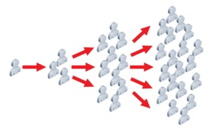

Customer Relationship & Channels
Notes:
Using the Business Model Canvas, we determined the best way to contact and develop customer relationships. One-on-one personal contact and social media. Our channels will be word of mouth , social media and reaching out to spokespeople and industry influences. This is backed by our current stage customer research of how realtors find out about products (from 9 realtors and 6 clients)
1:1 meeting
Social media
WoM

Slide 31

ReferMe

Slide 32









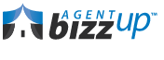


Competitors Space
Leading on Product
Quality, Innovation, Differentiation
ReferMe
Leading on Cost
Leading on Relationships
Efficiency, Hassle Free, Guaranteed Price
Customer Intimacy, Responsibility
Notes:
In Market research, there is no one like us who is creating a professional, social network based referral system.

Slide 33
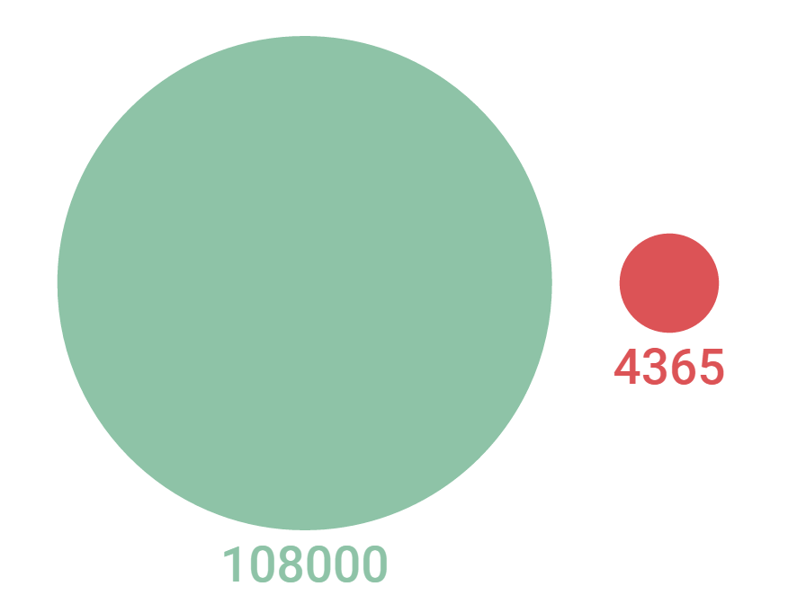
Realtors Market Size
Target Segment:
Top 15%
Less than 12 year in industry
Notes:
Instead, we pivoted to a larger segment, which would help us capture a larger paying market of early adopters.

Slide 34

Realtors Market Size: Canada, Per Year
TAM
$65 Million
Top 15%, less than
12 years in industry
SAM
$4.8 Million
Targeting Vancouver, Toronto, Calgary
SOM
$2.6 Million
Notes:
Thus we can achieve 2.6M dollar worth of revenue annually, in the first 3-4 years, targeting Vancouver, Toronto and Calgary realtors

Slide 35


Key Activities & Key Resources
Notes:
Our key activities are software development and customer relationships, and our key resources is the software server, programmers and connections we will establish with our customers.

Slide 36
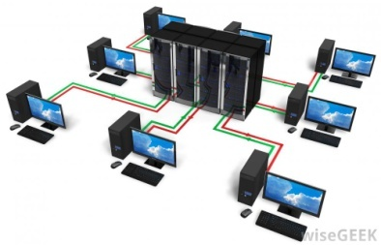


Key Activities & Key Resources
Notes:
Our key activities are software development and customer relationships, and our key resources is the software server, programmers and connections we will establish with our customers

Slide 37





ReferMe

Slide 38
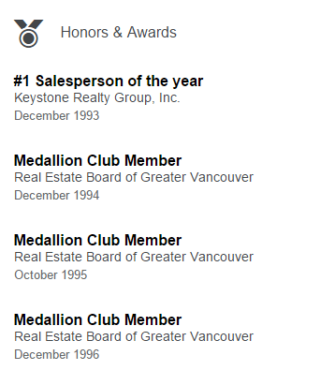
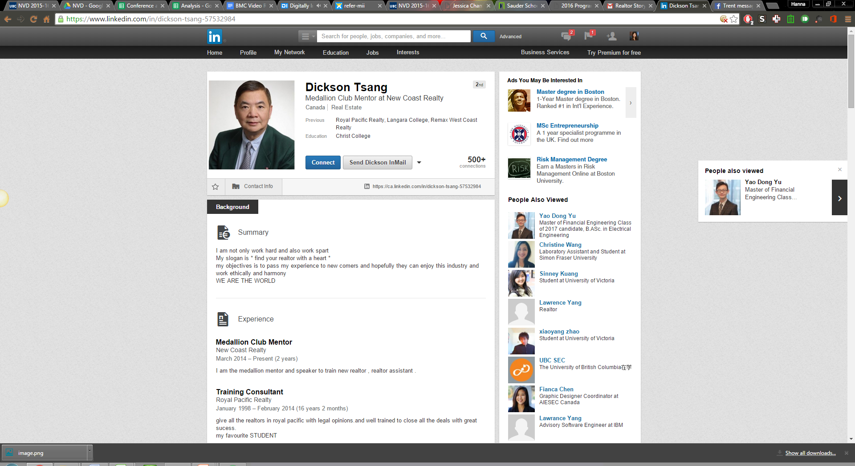
Support and Validation
Dicksen Tsang
Notes:
During our customer discovery, we pitched to Dicksen Tsang, lead realtor of the South Granville New Coast Realty.
*New Coast Realty

Slide 39
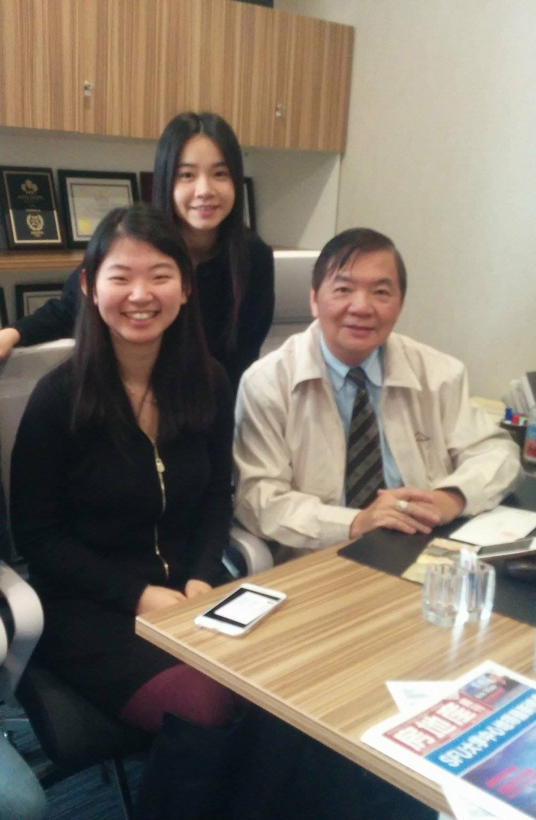
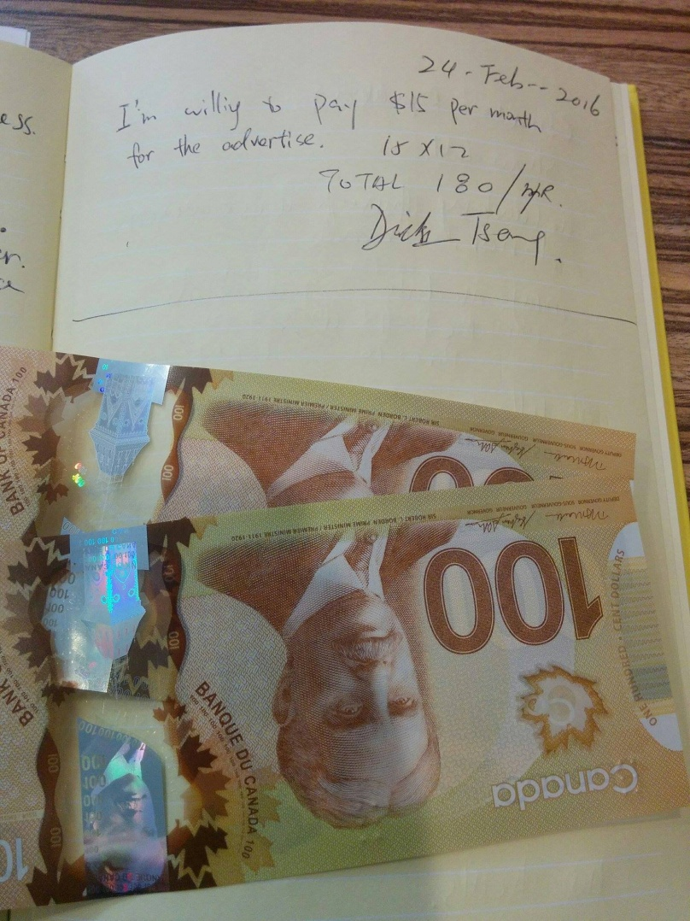
Support and Validation
Notes:
He was extremely interested and even offered money for the product. Here is his signed letter of intent.

Slide 40
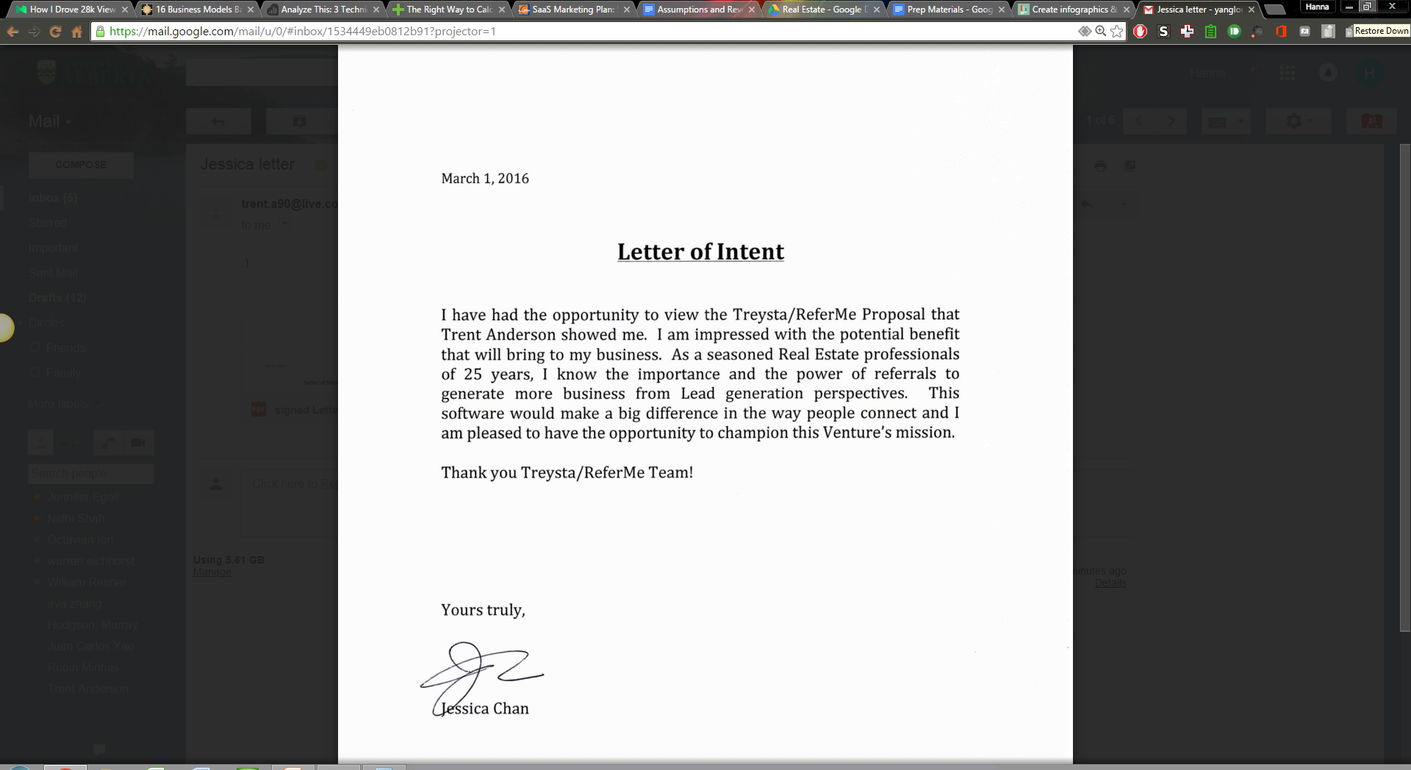
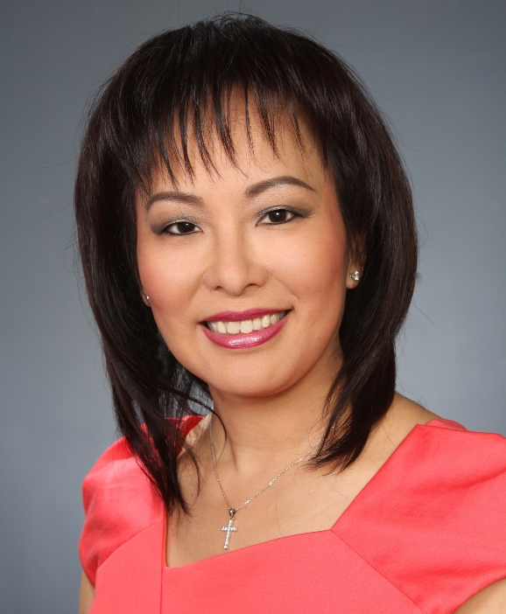

Support and Validation
Jessica Chan
Notes:
Jessica Chan, one of the top realtors in Western Canada and has earned more than 10 million in gross commissions, is also backing us up.

Slide 41

ReferMe

Slide 42


Revenue Streams and Pricing
Option 1:
Option 2:
Monthly
Subscription
Pay
Per Lead
Notes:
Researching Market streams, we hypothesized that a monthly subscription would have been the best revenue stream. However, most real estate websites gain revenue from advertising or a freemium model.

Slide 43


Revenue Streams and Pricing
Option 1:
Option 2:
Monthly
Subscription
Pay
Per Lead
Option 3:
Option 4:
Advertisement
mium
Notes:
Researching Market streams, we hypothesized that a monthly subscription would have been the best revenue stream. However, most real estate websites gain revenue from advertising or a freemium model.

Slide 44
Revenue Streams and Pricing
Option 1:
Option 2:
Monthly
Subscription
Pay
Per Lead
ex:
Option 3:
Option 4:
Advertisement
mium
ex:
ex:
Notes:
Researching Market streams, we hypothesized that a monthly subscription would have been the best revenue stream. However, most real estate websites gain revenue from advertising or a freemium model.

Slide 45
Revenue Streams and Pricing
Option 1:
Option 2:
Monthly
Subscription
Pay
Per Lead
ex:
Option 3:
Option 4:
Advertisement
mium
ex:
ex:
Notes:
Researching Market streams, we hypothesized that a monthly subscription would have been the best revenue stream. However, most real estate websites gain revenue from advertising or a freemium model.

Slide 46
ReferMe
mium
Advertisement

Slide 47





Cost Structure
Notes:
We predicted our break even point.

Slide 48
Projected EBITDA 2016 - 2019
Notes:
ReferMe, with a purely Freemium model, will break even in three years. This is based off of 16% growth, similar to our competitors.
`

Slide 49




ReferMe
mium
Advertisement

Slide 50
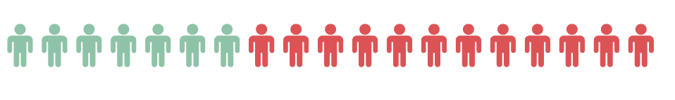
Summary
Stage 1:
Paperwork
Care about client
Leads
Trust
7 realtors
12 homebuyers
Notes:
We predicted our break even point.

Slide 51
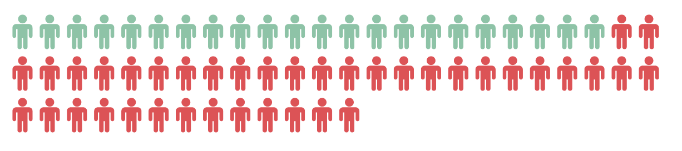
Summary
Stage 2:
Narrowed target segments
19 realtors
37 homebuyers
Notes:
We predicted our break even point.

Slide 52
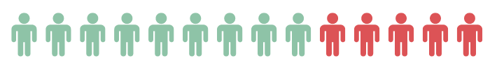
Summary
Stage 3 (Ongoing):
Revenue Model
MVP features
Channel
9 realtors
6 clients
Notes:
We predicted our break even point.

Slide 53
Summary
35 realtors
56 clients
91 TOTAL INTERVIEWS
2 Pivots

Slide 54
ReferMe
Trust the people you trust
Notes:
Thank you. We are ReferMe. Trust in the people you trust

Slide 55
Software Development
Aspiring Realtors:
A cloud based software that boosts lead generation by leveraging social networks of prospective clients to connect them and provides performance analytics
GET:
Tailored 1:1 meeting
& Incentives
Aspiring Realtors:
Avg. 5 to 10 years experience
Seeking to increase lead generation
positive outlook for social networks as a work tool
SaaS
Marketing
Realty Brokerages
KEEP: Events
& Customer Service
Sales / Cu. Acquisition
PR:
Agencies
Newsletters
Customer / Tech Support
GROW: Referral/WoM
API
Facebook
LinkedIn
Email Services
Unconnected
Homebuyers:
A cloud based software that leverages clients’ social networks to offer testimonials from trusted connections so that users (homebuyers) can be connected with a realtor
Unconnected
Homebuyers:
Lack access to easily recommended realtor
Possess a strong social connection/network
Aspiring young professional 20 to 35 years old
Bad experience with realtors
Website E-Commerce
Business Model Canvas
Website Server
Local Businesses (Incentive Sponsors)
On-Site:
Events
Conferences
Tradeshows
Tailored 1:1 meetings
Developers
Salesforce
Website: DNS fees, Hosting fees
Freemium
Marketing: Ads, SEO, PR, conference, collaterals, special events
Pay per Success (Commission of Commission)
Future Stage: Advertisement of third party networks/markets
HR: Developers, Salesforce, Customer/Tech Support team
Mix Model: Subscription + Pay per Success
Overhead: rent, supplies

Slide 56
Financial Model Assumptions
Two student will continue the business: one taking on the product development role (70K/year) & one taking on the customer development role (50K/year).
One engineer will be hired Q3'16 (70K/year)
One sales person will be hired Q4'16 (50K/year)
Customer/tech support will be hired in Q1'18 (45K/year)
Staff
Software
Beta will be released in Q3’16 with private invitations
Alpha will be released in Q1’17
Conversion (user) rate to premium model will be 14 %of total realtors in Canada. Rates based on Trulia and Zillow models.
Assume 90% of realtors of direct contact sales sign up as a free user
Customers
~20 realtors/week goal, with Base Diffusion Model for word of month growth
~$1200/quarter account expense (cost) for coffee for tailored 1:1 meetings
~$400/quarter for focus groups of 40 people
~$75/quarter for social media advertisements
~$100/quarter, growing to $300/quarter for General and Admin
Acquisition

Slide 57
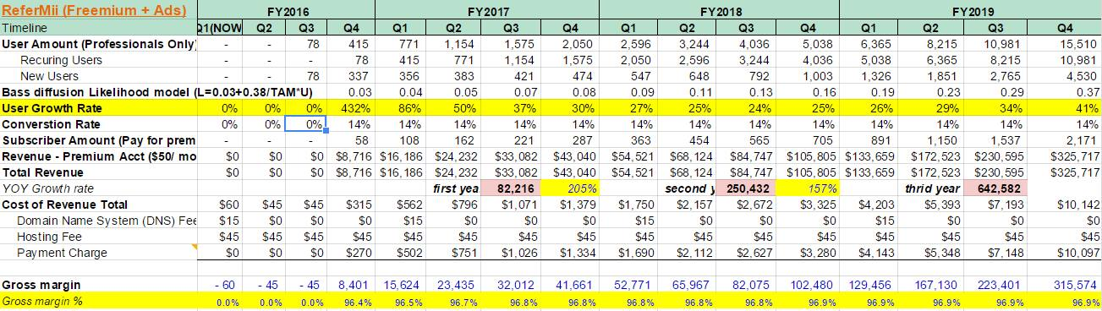

Slide 58
Quarterly Revenue Forecast & Cash Balance 2 years

Slide 59
Quarterly Revenue Forecast & Cash Balance 4 years

Slide 60
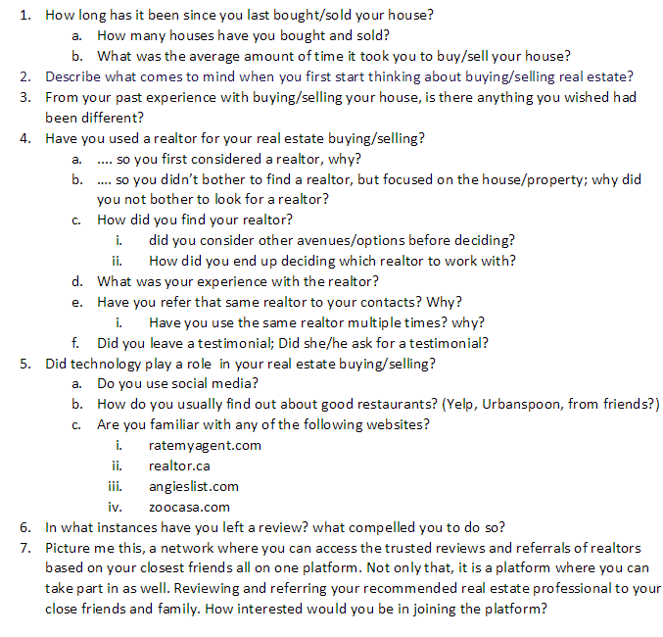
Phase 1: Homebuyer Questions

Slide 61
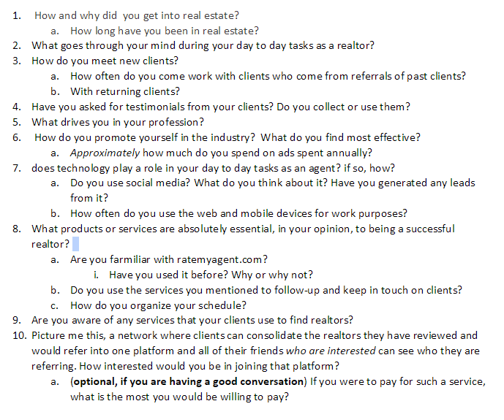
Phase 1: Realtor Questions

Slide 62
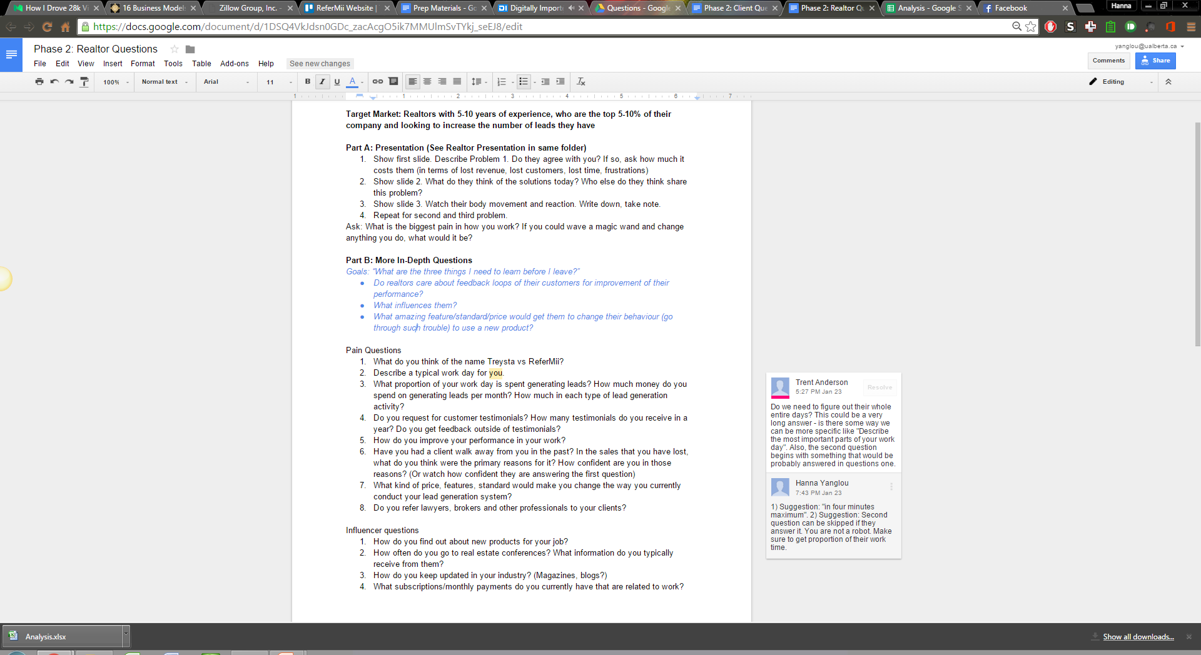
Phase 2: Needs Investigation

Slide 63
Phase 2: Realtors

Slide 64
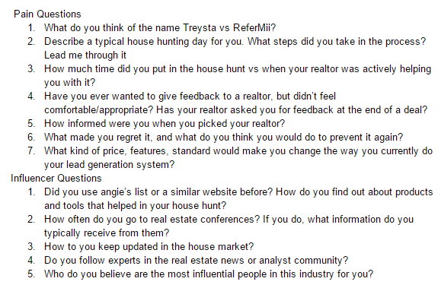
Phase 2: Homebuyers

Slide 65
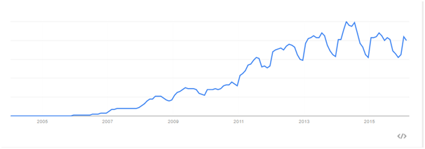
trulia
Google Trends: 8/year.
54Mil 2014-2007. If we assume linear growth, 7.7Mil users per year. If all realtors in US were using Trulia, their realtor base would make up 2% of the total market base.
Total revenue was 67.1M*4=268.4*10^6
Average user payment is 125$/month or 1500$/year
Paying realtors are 1.789*10^5
Conversion rate: 1.789*10^5/1.1M=16%

Slide 66
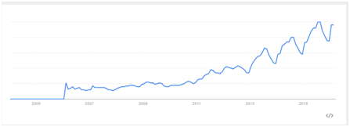
Zillow
Google Trends: 7.5/year. 26 (feb 2006) to 91 (feb 2015)
83Mil 2014 ~ 10.4Mil/year
369.2$ revenue in 2014 (92.3$ quarterly)
we know average realtor spends 320/month in zillow or 3840$/year - on average we have 9.614*10^4 realtors paying 320 per year.
In 2014, let's assume most realtors in the US signed up and are using Zillow (free and paying customers) - 83*10^6*0.01=8.3*10^6 realtors
Conversion rate: 9.614*10^4/8.3*10^6=11.5%

Slide 67
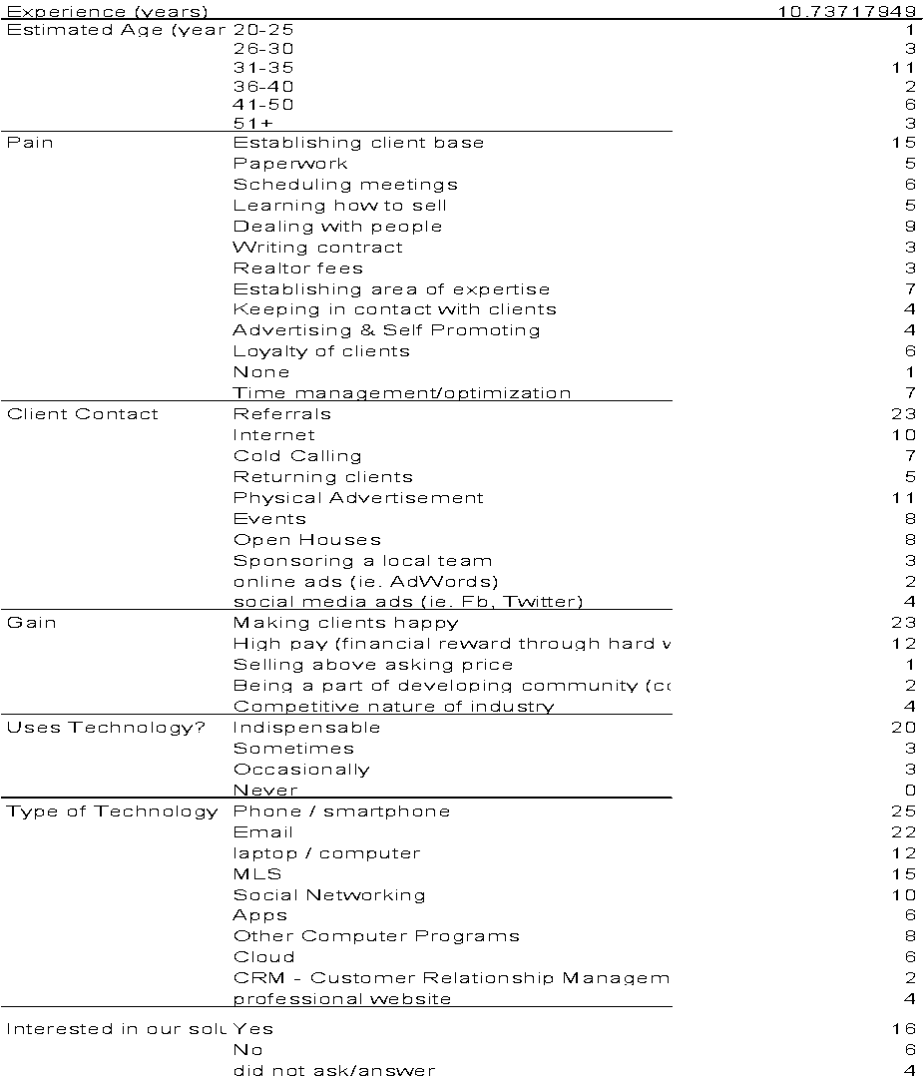
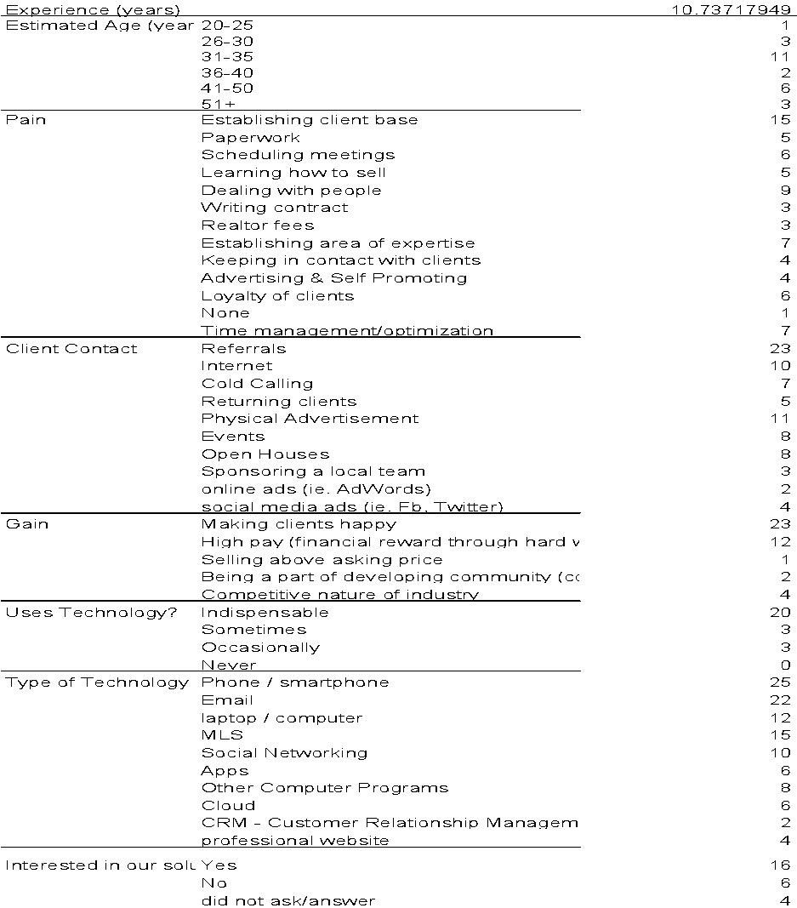
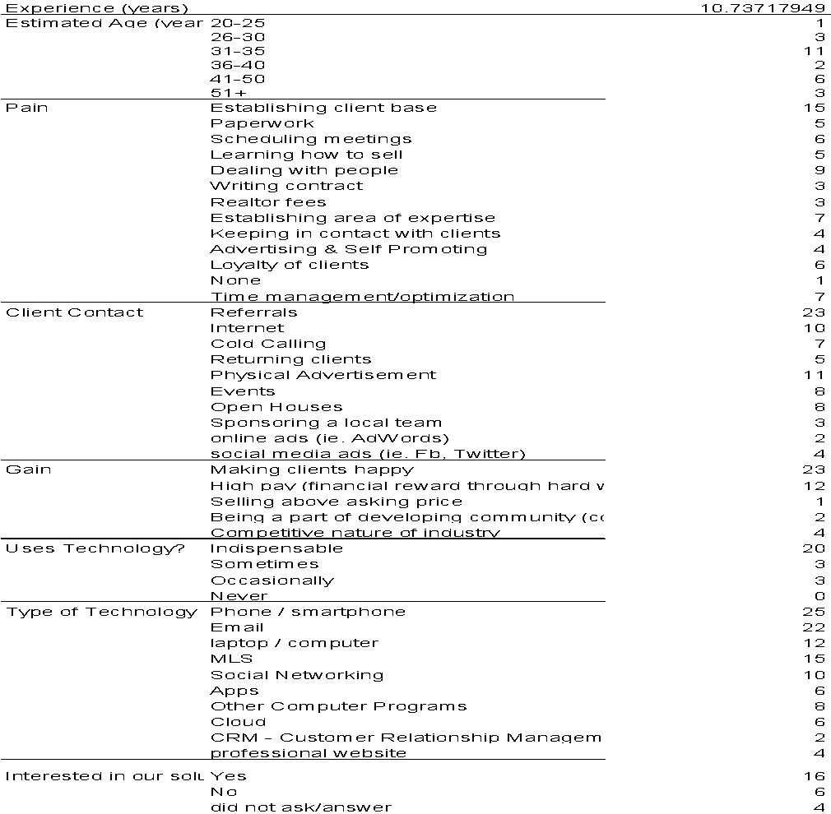

Slide 68
Realtor Found by? | Referral | 26.0
 | Within Family | 9.0
 | Within Friend | 16.0
 | Walk-in / Booth / Offices | 5.0
 | Interviews | 2.0
 | Realtor was client | 1.0
 | Internet Search | 4.0
 | Sponsored group and found that way | 1.0
 | Listing Advertisement (in area) | 5.0
 | Newspaper/ Magazine Advertisement | 1.0
 | Did not Use | 2.0
 | Don't remember | 1.0
Technology | Indispensable | 22.0
 | Often | 8.0
 | Occasionally | 10.0
 | When needed | 3.0
 | Never | 2.0
 | Did not ask/answer | 4.0
 |  | Count
Time in market | (months) | 4.7
Time Since last buy/sell | years | 15.6
Estimated Age (years) | 20-25 | 10.0
 | 26-30 | 12.0
 | 31-35 | 12.0
 | 36-40 | 3.0
 | 41-50 | 7.0
 | 51+ | 4.0
Gains | New house | 33.0
 | Loved Realtor | 16.0
 | Customize house | 7.0
 | More knowledge about housing market
 | Play with budget | 14.0
 | N/A
Pains | Looking for a house | 30.0
 | Turnover Rates | 7.0
 | Time to look at houses in person | 12.0
 | Finding someone with experience | 11.0
 | Scheduling meeting with realtor | 4.0
 | Stress in buying | 17.0
 | Finding the most suitable house | 6.0
 | Trust | 11.0
 | Problems with buyer | 2.0
 | Issues outside of realtor process | 6.0
 | inexperience | 9.0
 | Didn't know laws of the area | 4.0
 | Language barrier | 2.0
 | Finance | 14.0
 | Housing Inspection problems | 4.0
 | Dealing with realtors not my own | 1.0

Slide 69
Type of Tech | iPad/iPhone app | 10.0
 | Email | 17.0
 | Web browser / computer | 33.0
 | Text | 11.0
 | Phone calls | 14.0
 | Virtual Tours / slide shows | 7.0
 | MLS | 21.0
 | Google Maps | 8.0
Did they use App? | Yes | 6.0
 | No | 28.0
would consider using? (Our Product either on App+Browser) | Yes | 29.0
 | No | 4.0
 | Did not ask/answer | 15.0
Experience with Bad realtor? | Yes | 17.0
 | No | 30.0
 | N/A | 2.0
Best part of Realtor | Accomodating | 21.0
 | Knowledgable | 27.0
 | Friendly | 20.0
 | Honest (trust) | 19.0
 | Made process smooth | 13.0
 | Gave gifts | 4.0
 | Patient | 6.0
 | Not pushy | 15.0
 | Efficient | 8.0
 | Inclusive | 7.0
 | Personable | 16.0
 | Punctual | 8.0
 | Prepared | 10.0
 | Prioritize Clients' interest | 5.0
 | Neutral (no Agency problem) | 7.0
Signed Exclusivity Agreement? | Yes | 1.0
 | No, but only used one realtor | 10.0
 | No, and used more than 1 realtor | 8.0
 | Did not ask/answer | 27.0
Social Media | Facebook | 16.0
 | LinkedIn | 10.0
 | Instagram | 9.0
 | Yelp | 0.0
 | WeChat | 6.0
 | Other (specify) | 3.0
 | None | 2.0
Familiarity with competition | rankmyagent.com | 3.0
 | realtor.ca | 19.0
 | angieslist.com | 6.0
 | zoocasa.com | 3.0
 | buzzbuzzhome.com | 1.0
 | rew.ca

Slide 70
Problem
You find a realtor, but as you continue to work with this realtor, you start feeling uncomfortable.
The realtor’s personality and methods don’t match with you, or you don’t trust him, or you start feeling as if you’re not in control of this sale and process. Or maybe he isn’t as experienced as you like and you’re becoming hesitant about this big purchase
Today’s Solution
Before the realtor, you asked family and friends to recommend you a good realtor.
Your realtor is a friend you know or someone from your family
Our Company’s Solution
We connect you with your friends and family online to see a multitude of options and realtors they have used, for what reason and their experience of the realtor for a informed and well-matched decision

Slide 71
Problem 1
You don’t earn as much money as you want or can.
Today’s Solution
You spend a lot of money on advertising methods that have some return, but not worth the investment overall.
Bus benches, flyers, magazine and newspaper ads and also a personalized professional website, to name a few.
Our Company’s Solution
Your past and present clients build your referral network for you using their personal connections.
As a result, more leads means more chances to close a deal and ultimately make more money.

Slide 72
Problem 2
Generating quality leads is time consuming.
Today’s Solution
You advertise through friends and family, asking them to spread the word
You try to get out there and meet people face to face
You create a personal website, post listings, to create visibility
Our Company’s Solution
New clients can reach out to you online through previous clients, friends and family you have already established a relationship with, without having to directly go through their primary connection.

Slide 73
Problem 3
Generating quality leads is time consuming.
Today’s Solution
Work for X number of years in the industry, establishing your brand name slowly while bending over backwards for some clients.
Spend a ton of money in clever ad campaigns to build your image to where you want it to be.
Our Company’s Solution
Harness the power of testimonials and reviews of past and present clients in one convenient and easy to access online space.
Generate quality leads through this trusted review space while building your personal brand & image

Slide 74
Website | Researcher | USP (Pro) | USP(User) | Revenue Model | Price (Client) | Price (Realtor)
Spacelist.ca | Hanna | Analytics, API for listings, promoted listings | Collection of listing, map locations, easy interface | Freemium | Free | Free/49.99 upgrade
Zomato.com | Hanna | SAAS (Various utilities and apps) | Regularly updated content and lots of info on restuarants | SAAS, Advertising | Free | Based on location. Per ad, use of apps.
Rankmyagent | Trent | Comprehensive review system | Local, reviewed and trusted agents. | N/A | Free
AgentBizzup.com | Adrian | Easy way to build website, specifically for realtors. Cloud, analysis, customization | N/A - one sided | Subscription | N/A | Monthly - 8.88/15.99/29.99/59.99 Yearly - 5.99/12.99/24.99/49.99 per month
Zillow | Trent | Visibility - 22M visitors. | Zestimate. Anonymous rating. Beautiful search UI | Advertising | Free | $50 per lead, $0.10 per view of ad, avg agent spends $320/month but range from $500 to $10000 a year
Trulia | Trent | Visibility. Positive reviews. | GOogle search for houses | Advertising | Free | $30-$200+ PER MONTH for Realtors
Homeurbano | Ava | N/A | Safer, more reliable source of accomadation (than cragilist). Demand for furnished places for foreigners. | Commision | Agency Fee based on amount of months you rent the apartment (eg 3000$ apt for 6 months = 50% fee of 1500$ | N/A

Slide 75
Airbnb | Hanna | Turn underused assets into money | Cheaper than hotels | Commision | 6-12% of accomodation +VAT | 3% service charge + VAT
Yelp | Hanna | Visiblity and reputation - helps "local businesses" | Automated software to recommend most helpful and reliable reviews | Advertisements | Free
Ratemyagent.com.au | Ava | Common platform to demonstrate experience and sales ability | Find and follow leading agents who are selling properties they want to buy. Research value | Freemium | Free | 0/39/69 AUS$/month Agencies: 0/99+29per agent or 299 unlimited agents/ 149+59 per agent or 499 unlimited agents
Trivago | Adrian | N/A does not direclt connect with hotels | Consolidates information from different travel sites. International | CPC (Cost per click) model. Booking sites are paying trivago for the clickouts trivago's users generate on their offers. | Pays a little extra to site (scrapping) | N/A
Zoocasa | Alan | We give you leads, you don't need to work | Zoocasa finds you the optimal realtor for you based on their own pool of curated realtors | Commission | Free | 0.25-35% of realtors
Realtor.ca | Juan | N/A | Personalized search function, save button for places you like | N/A | Free
AngiesList | Alan | Visibility | People you trust - reviews you trust from local neighbourhood. | Advertising | $4.00

Slide 76



Advertisement
Realtor
New Leads
Turn to inner circle

Slide 77


Advertisement
Realtor
New Leads
+trust
Turn to inner circle

