Slide 1
Group 11 MECH 328
TrailRider Redesign

Slide 2
Members
Matthew Vogler – Thermofluids
Alisa Walsh – Biomedical
Graham Williamson – Mechatronics
Ruozhou Zhuang – General
Kevin Chu – General
Yihan Yanglou – General
David Lunn – General

Slide 3
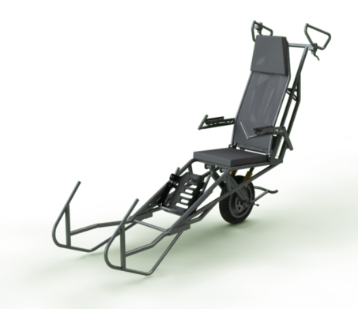
Introduction
Value Proposition
Stakeholder Identification and Needs
Evaluation Criteria and Requirements
Description of Final Design
Recommendations
Strategy
Development Costs
Conclusions
Verifications

Slide 4
Value Proposition
To provide a next-generation TrailRider design that expands the range of people who can ride safely on the device as well as expand the range of potential assistants that can safely use the TrailRider to take riders into the rough terrain that the current design can access.

Slide 5
Identified Stakeholders
Stakeholder | Influence on the Project
BCMOS | High
Riders | High
Assistants | High
Manufacturer | Low
Other Trail Users | Low
Parks BC/Canada | Low

Slide 6

BCMOS’ Major Needs
Device materials and construction are affordable
Maintenance and cleaning procedures are minimal
Device is reliable and impact resistant
(from facebook.com/BritishColumbiaMobilityOpportunitiesSociety)

Slide 7
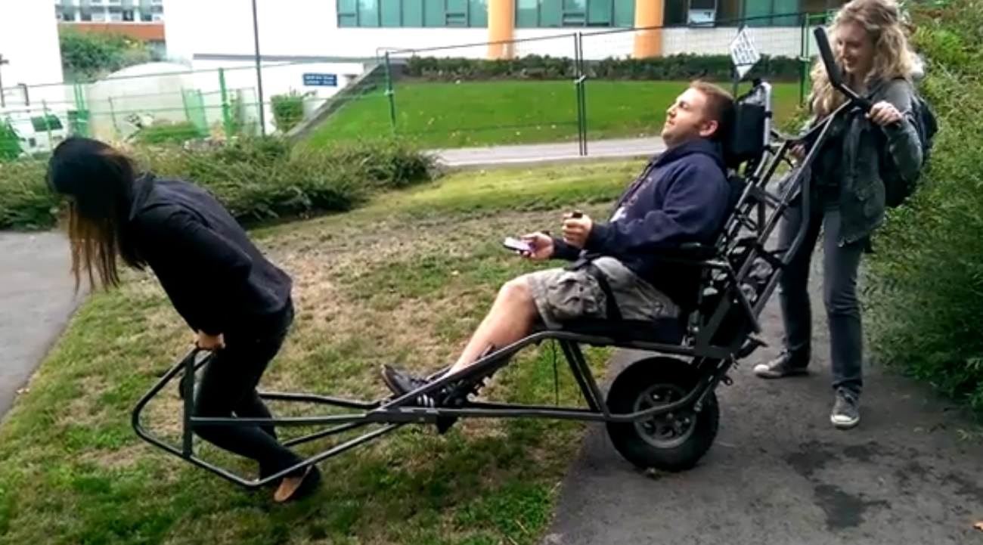
Assistants’ Major Needs
Device is ergonomically comfortable for assistants to operate over long periods of time
Device can be carried over large obstacles
Device is less physically demanding on the assistants, it requires less strength, endurance and height

Slide 8
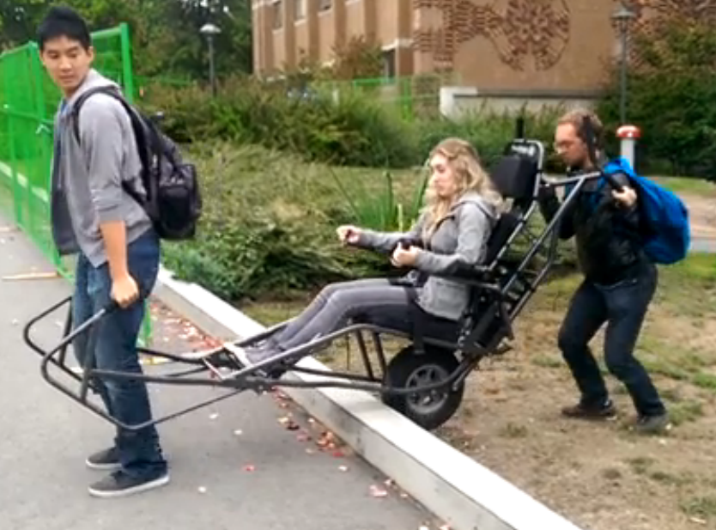
Riders’ Major Needs
Device reduces transmission of shocks to the rider
Device has improved comfort over current generation design
Device has improved rider safety features over current generation design
Device secures rider sufficiently to prevent slipping in chair
Device allows for user interaction from rider

Slide 9
Needs to Requirements and Evaluation Criteria
BCMOS
Need | Requirement or Evaluation Criteria
Affordable construction and material | Both
Minimal maintenance | Evaluation Criteria
Reliable and impact resistant | Both

Slide 10
Needs to Requirements and Evaluation Criteria
Assistants
Need | Requirement or Evaluation Criteria
Comfortable over long periods of time | Evaluation Criteria
Can be carried over obstacles | Both
Less physically demanding for assistants | Evaluation Criteria
Adjustable for assistant sizes | Both

Slide 11
Needs to Requirements and Evaluation Criteria
Riders
Need | Requirement or Evaluation Criteria
Affordable construction and material | Both
Minimal maintenance | Evaluation Criteria
Reliable and impact resistant | Both
Need | Requirement or Evaluation Criteria
Shock transmittance | Both
Improved rider comfort | Evaluation Criteria
Improved rider safety | Evaluation Criteria
Prevent slipping in chair | Evaluation Criteria
User interaction | Evaluation Criteria

Slide 12
WDM Evaluation Criteria

Slide 13
WDM Evaluation Criteria
Assistant Comfort
Adjustability for Assistants
Assistant Energy Conservation
Durability
Maintenance
Cost
Turning Ability
Manufacturing Time
Shock experienced by rider
Rider Comfort
Rider Adjustability
Degree of Rider Interaction
Braking Power
Total Weight
Transport Size
Obstacle Climbing Ability

Slide 14
Evaluation Criteria
Need | Evaluation Criteria
Affordable material and construction | Cost
Minimal maintenance | Maintenance
Reliable and impact resistant | Durability
Comfortable for assistants over long periods of time | Assistant comfort
Can be carried over obstacles | Weight
Less physically demanding for assistants | Assistant energy conservation
Adjustable for assistant sizes | Adjustability for assistants
Shock absorbance | Shock experienced by rider
Improved rider comfort | Rider comfort & Rider adjustability
Improved rider safety
Prevent slipping in chair
User interaction | Degree of rider interaction

Slide 15
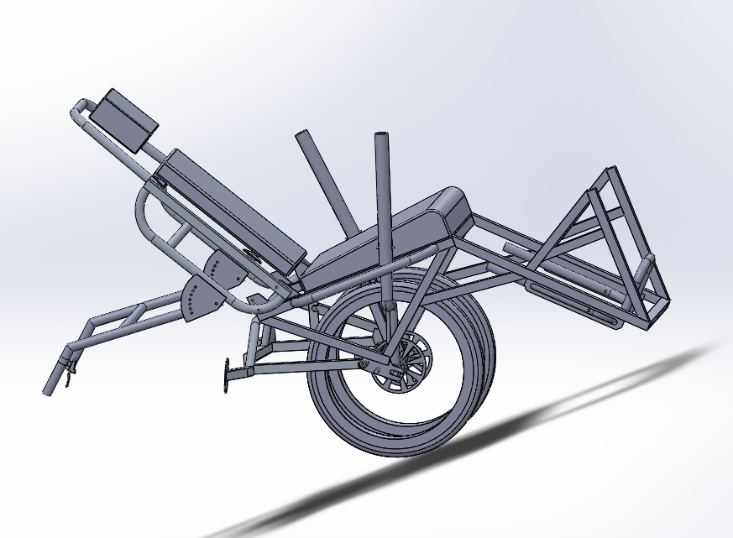
Final Design
Two wheels that rotate independently
Direct drive levers for rider assisted movement
Cord handles used by the front Sherpa for pulling
Angled wedge seat
Soft fabric side flaps
Mechanical disc brakes on each wheel controlled by the rear Sherpa
Four point harness for Rider
Possible operation by one Sherpa

Slide 16
How it Works - Operation with Levers
Pulled by front Sherpa
Pushed, steered and brakes controlled by rear Sherpa
Rider can push on the levers to generate torque
Rider is secured by a four point harness to a seat with an adjustable back
Adjustable rear handles for assistant adjustability

Slide 17
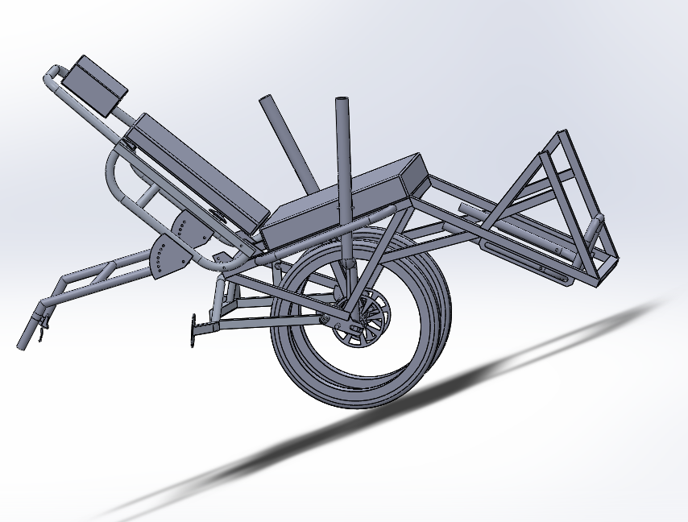
Two Seat Options for different riders :
Flat Seat
Wedge Seat

Slide 18
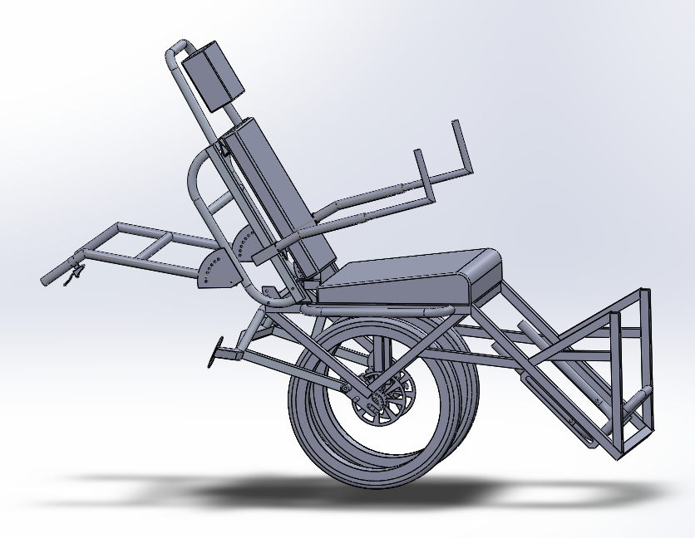
How it Works - Passive Rider Operation
Levers are removable
Adjustable arm supports can be connected to square tubes on the sides of the chair
Adjustability is the same as existing, with telescoping tubes
Alternative for riders who lack arm strength
Recommended option for younger riders

Slide 19
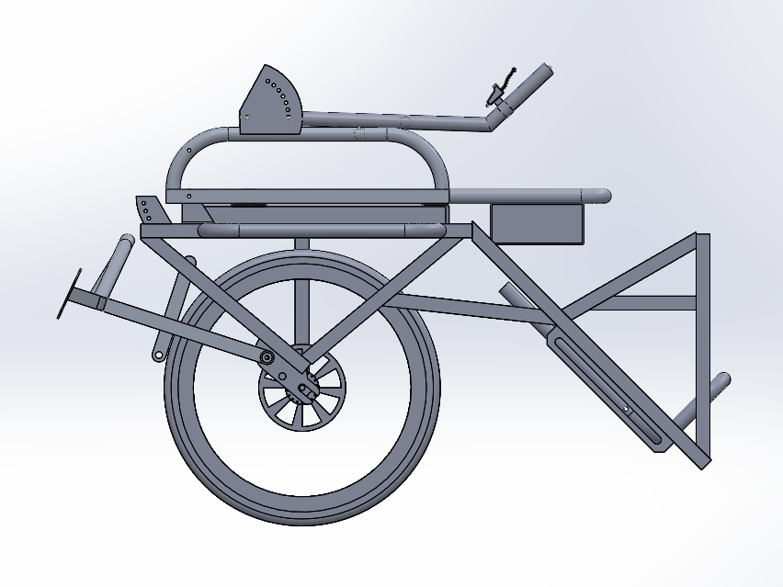
How it Works - Transportation
By removing the seat and pins holding the handles and back of seat in place the device can fold up.
For transportation the levers should be detached from the spline attachment by removing the pin
Total Dimensions for Transportation:
  Proposed 32.5” x 46.87” x 27.38”
  Existing 40” x 61” x 25”
More compact than existing design due to cord handles, and compact folding

Slide 20
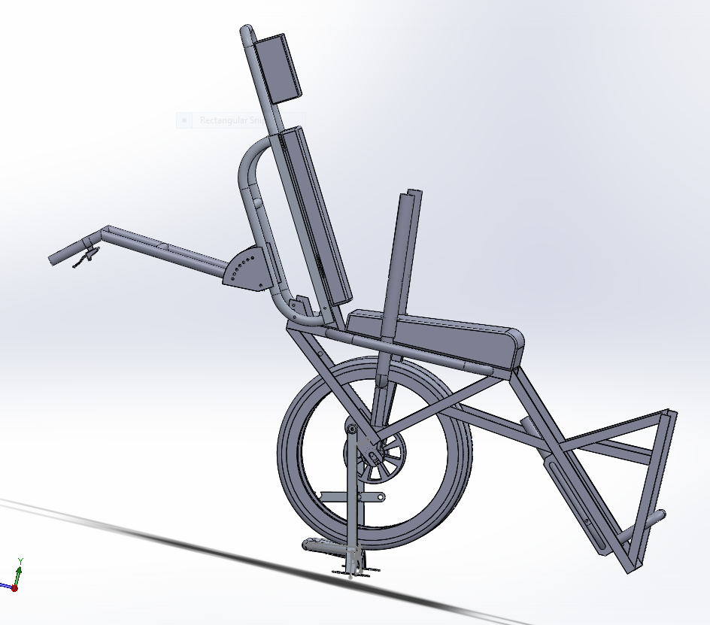
How it Works - Parked
The proposed design has an additional foot lever that can be pushed down by the rear assistant while lifting the rear of the device.
Design makes it easier to engage for weaker assistants
Functions the same as existing design.

Slide 21
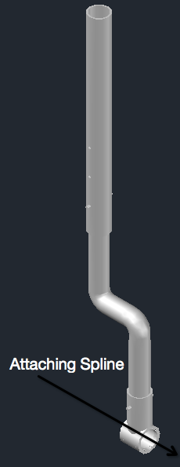
Lever System
Lever attaches directly to spline on bicycle freehub
Rider can change applied torque by adjusting hand position on levers
Telescoping Aluminum tubes allow for a max lever arm of 32 inches
As an example of effectiveness, levers can provide a 46% reduction in required assistant energy input during a hill climb assuming:
  175 pound rider (Total Weight = 225 lbf)
  Incline Angle of 15 degrees
  Maximum lever arm of 32 inches
  Assistants move TrailRider at 2ft/s (25 RPM for 18" Wheels)
  Rider applies 20 lbf on each lever, producing 74 W of power
Rider can provide all energy in the flat surface and small incline

Slide 22
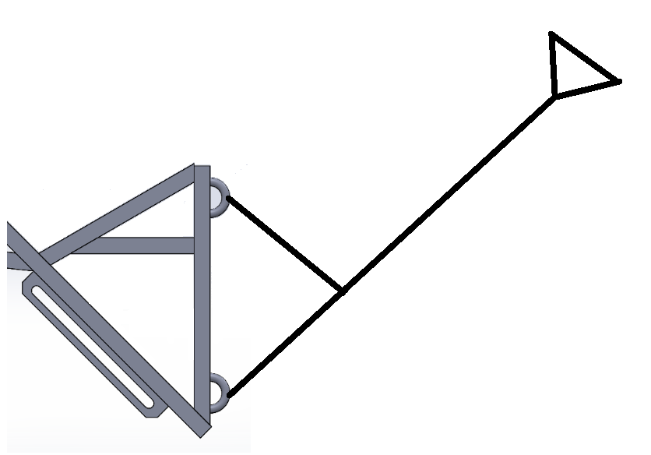
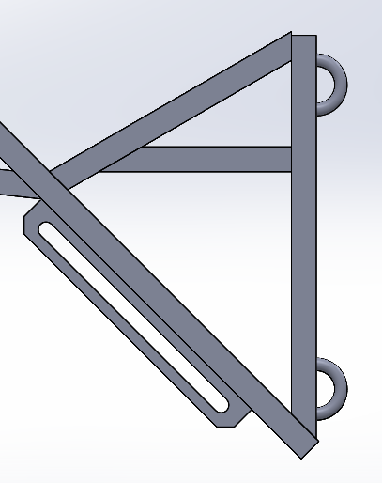
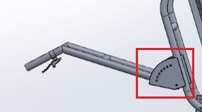
Assistant Interface
Cords are pulled by front assistant
Two points of connection
Cord length adjustable
Rear handles adjustable allowing wide range of assistants and better lifting position

Slide 23
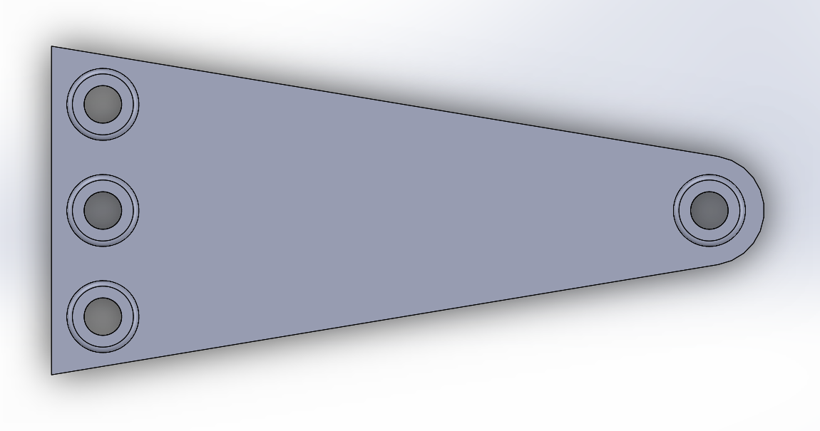
Seating Apparatus
Four point harness
Four fabric flaps restrain the rider
Two seat cushion options
  Flat
  Wedged

Slide 24
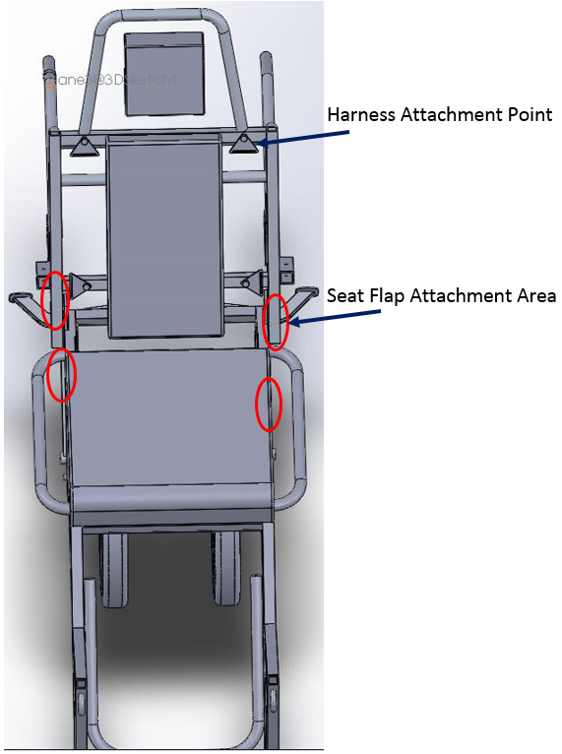
Seating Apparatus
Four point harness
Four fabric flaps restrain the rider
Two seat cushion options
  Flat
  Wedged

Slide 25
Chassis
Minimum safety factor calculated with FEA: 2.8
Used square tubes where possible
  Reduced material cost
  Less time required to notch the tubes
Compact since cord handles can be attached further back

Slide 26
Out of Scope Needs and Requirements
Improved Temperature Management
  Existing use of blankets was effective
  Majority of use by BCMOS is during summer
Quantifying shock reduction experienced by rider
  Seat material properties were proprietary or unknown
  Lacked info needed to perform detailed analysis for shock
  Estimates of deflection experienced were performed

Slide 27
How Features Address Requirements and Evaluation Criteria
Feature | Requirements and Evaluation Criteria Addressed
Direct Drive Levers | User Interaction Less physically demanding for assistants
Fabric Side Flaps | Improved rider safety Adjustable for assistant sizes Reduces slippage
Four Point Harness | Improved rider safety Reduces slippage
Wedge Seat Option | Adjustable for assistant sizes Reduces slippage
Cord Front Handles | Can be carried over obstacles due to handle design Comfortable for assistants over long periods of time

Slide 28
How Design Affects Value Proposition
Feature | Increased Range of Riders
Fabric Side Flaps | Upper-body immobility Children Reduces slippage
Four Point Harness | Upper Body immobility
Wedge Seat Option | Reduces slippage
Feature | Increased Potential Assistants
Cord Front Handles | Reduction in tilting during operation Ergonomics and comfort
Dual Wheels | Reduction in tilting during operation Possible operation by one Sherpa
Feature | Increased Potential Riders | Increased Potential Assistants
Direct Drive Levers | Interaction in hike | Option for weaker assistants to match up with stronger upper-body riders

Slide 29
Final Recommendations
Discuss chassis design with manufacturer to optimize the manufacturing process
Purchase and attach wedge seat to current design to allow for testing
Investigate different tire treads
Additional work done on lever ergonomics
  Grip type and position
  Height adjustments
  Lever contour
Evaluate effectiveness of one assistant operation with first redesigned TrailRider
Removability of tires would allow significant reduction in transportation size of device

Slide 30
Strategy and Resource Management
Divided work among multiple sub-teams
  Improved efficiency
  Used team meetings for sub-team updates and major decisions
  Assign responsibilities and focus on specific aspects
Utilized a variety of project management chart and documents
Planned ahead for possible scheduling conflicts
  Midterms - planned for individual work to be done in team meeting times

Slide 31

Compare Initial Time Estimates to Actual Time Required
  Strategy and Resource Management
    Only delay was dividing report responsibilities amongst teams, 4 hours
  Concept Selection
    AHP took approximately 18 hours longer than anticipated
    2 Pugh Charts required 15 additional hours
  Design in Detail/Final Report
    FEA analysis took 6 hours longer than budgeted
    SolidWorks Modeling took 22 additional hours

Slide 32
Changes in Strategy for Future Projects
  Initially divide into smaller sub-teams
  Try to schedule more tasks for the beginning of the project
  Set guidelines for sub-team task approach
  Outline what we want to get out of each part of the process ahead of time
  Organize all files at beginning of project

Slide 33
Engineering Development Cost
Total Development Costs = $126,600
Total Hours Spent = 844
Tutorials/Lecture
Meetings/Other | Tutorials/Lectures | Report/Presentation
643 hours | 63 hours | 138 hours

Slide 34
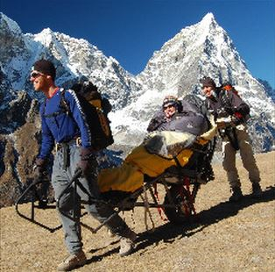
Conclusions
Total Lifetime cost of one TrailRider - $7400.64
TrailRider design is 26 % under cost requirement
Design meets all requirements
Design excels at many of the evaluation criteria

Slide 35
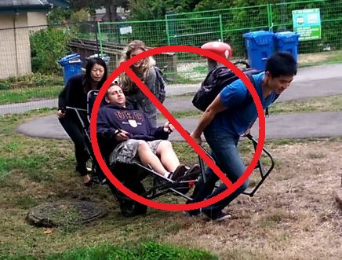
Verification
Value Proposition:
Expand the range of potential riders and assistants who can safely use and operate the TrailRider
Accomplishments:
The final design can potentially be used with a single rear assistant
BCMOS can now utilize the services of assistants all sizes and gender
Riders can now interact with TrailRider and environment

Slide 36
Questions and Answers

Slide 37
Additional Information

Slide 38
Least well Determined Features
Shock transmitted to the rider is not well determined
  Material properties of the specific seats are not given/known
  Estimations of displacements within the seat experienced by the rider were calculated
    Used ILD ratings and extrapolated the data to our situation
Cord comfort over extended use
  Potential attachments to a harness or back straps for front assitant

Slide 39
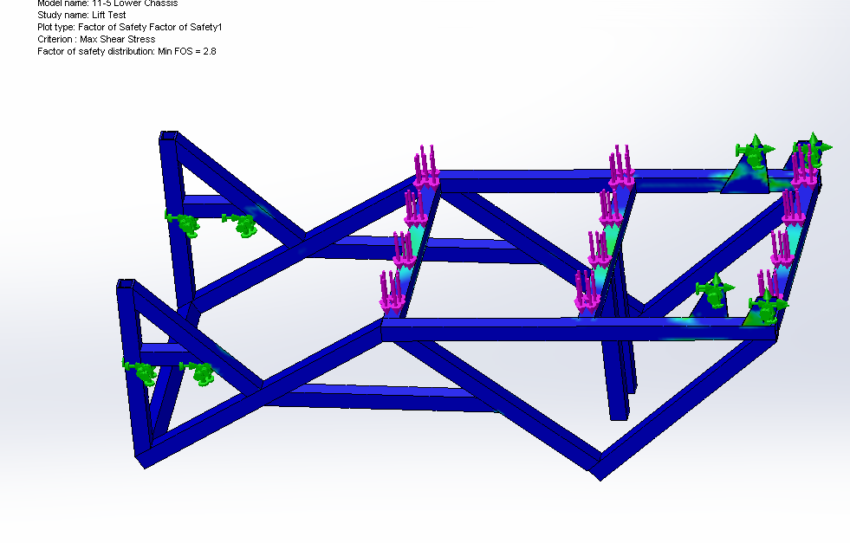
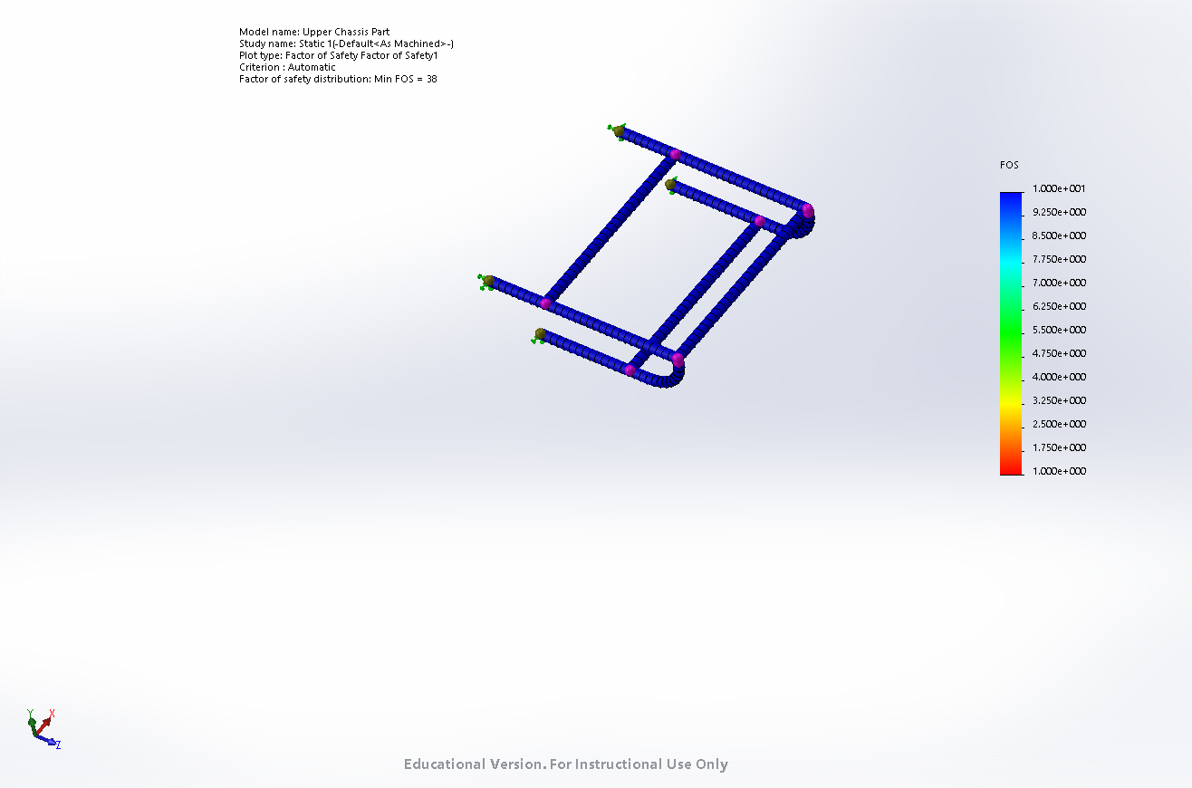
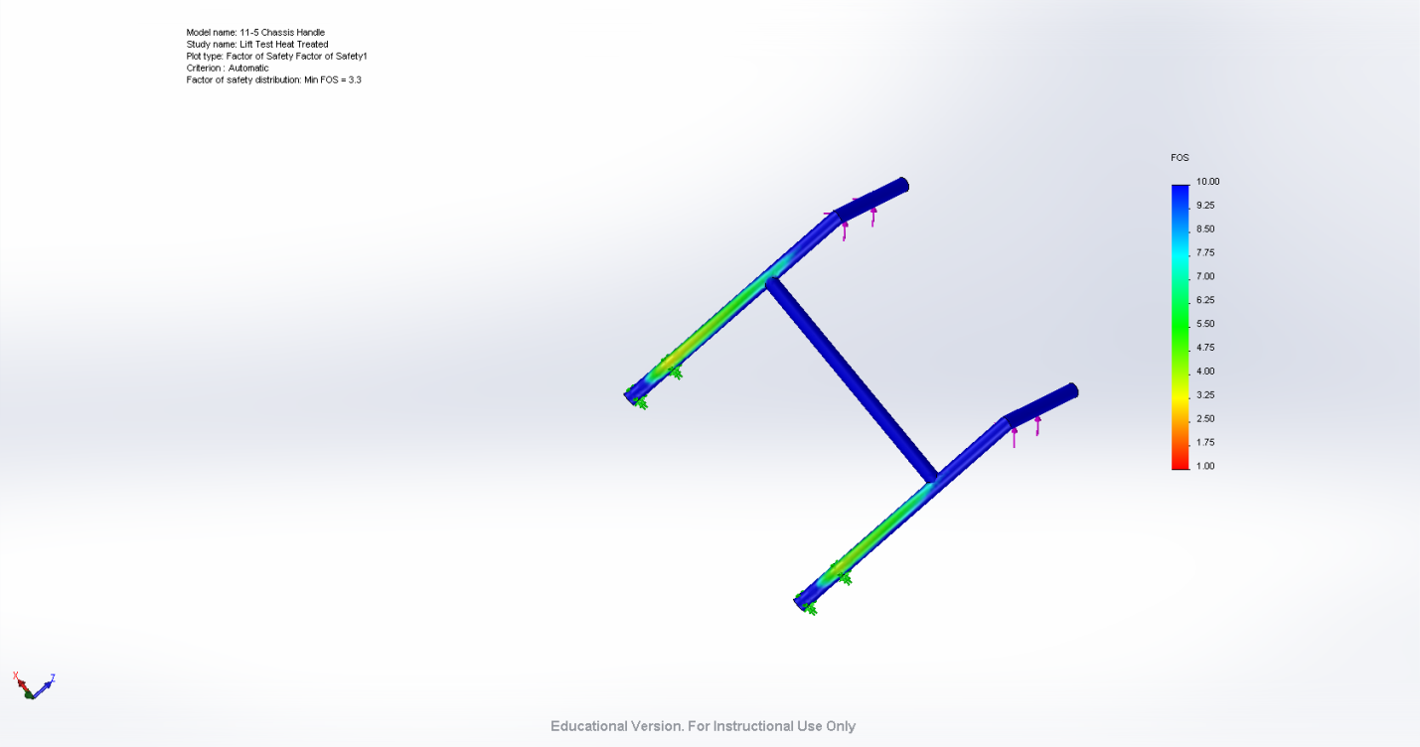
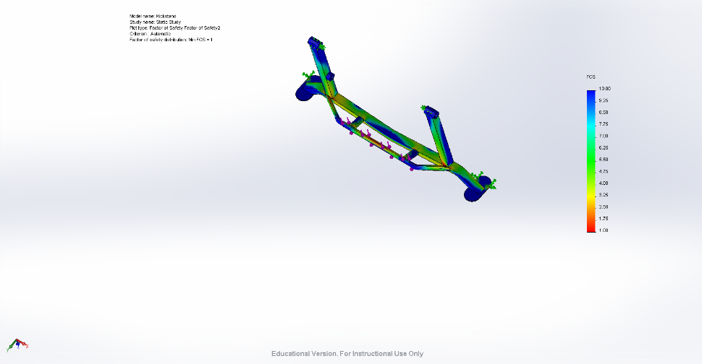
Major Failure Modes (FEA, DFMEA)
FEA
  6061 Aluminum for Force Analysis – extremely conservative
  Most critical was a lift test of 1100N (250lb) on the chassis
  Overall safety factor of 2.8
Notes:
Considered that welding will reduce strength in HAZ
conservatively used 6061 for FEA instead of 6061-T6
T6 is approx. 5x stronger than 6061
determined later that only 50% of strength is lost in HAZ

Slide 40
FEA Summary
Lowest Safety Factors from different tests
Lift Test: 2.8
Push Test: 2.9
Kickstand Foot Lever: 1
Considered worst case conditions

Slide 41
Major Failure Modes - Lever
Of concern was the potential for yielding of the thin (0.120") Aluminum tubing due to an applied force
An applied force would cause both bending stress due to the lever acting like a cantilever beam, and torsion due to the applied force being eccentric, relative the reaction forces at the lower pin
A yield stress calculation was performed to address this to ensure to ensure safety
Another concern was the potential for the rider to produce an applied force perpendicular to the forward facing direction of the TrailRider, causing excessive stress and potential damage to the entire freehub/wheel system
This was addressed by creating a support bar outside of the lever on the frame, so that the levers cannot be pushed in the wrong direction

Slide 42
Concept Development - Justification
Internal research conducted in the form of field trials with the current version of the TrailRider allowed our team to determine the main problem areas, and focus our efforts accordingly
In order to choose the best possible concept from the many possible concept fragment combinations, Winnowing and Pugh charts were split into two separate charts based on mutually exclusivegroups of top level functions (more determinativeand less determinative)
The best scoring concepts from these charts (4) were then evaluated in a singleWDM, using onlythe most importantevaluation criteria determined with the using the AHP technique
Iteration was then used to combine the highest scoring features from each concept in the WDM into the best possible and highest scoring final design

Slide 43
Design Justifications
Lever system allows for rider interaction through steering and propulsion, responding to the demand for a more interactive rider experience and a form a power assistance
Dual wheels allow for improved safety and balance, and reduce the amount of energy from the assistants to stabilize the TrailRider
Flexible cords for front Sherpa prevent the push/pull resistance encountered on the rigid body TrailRider, and allow for a smaller total volume for transportation
Adjustability of rear handles/brake location allows for a wider range of heights for the rear assistant
4 point harness and side flaps on seat help to stabilize and reduce slipping of the rider
Soft foam cushion, angled wedge seat helps to prevent pressure sores

Slide 44
Design Justifications - Chassis
Designed with square aluminum tubing for ease of construction
  Round tubes require complex notching when joining with other tubes
  Initial size was based off existing TrailRider and validated with
6061-T6 was used for tubing, 6061 was used for FEA analysis
  to account for loss of strength/heat treatment in HAZ of welds
  designed to avoid requiring reheat treatment
  initial assumption was later proved to be overly conservative
    Research found HAZ loses 50% of its strength
    With T6 it is actually 2.5x stronger than 6061 at the welds

Slide 45
Design Justifications - Assistant Interface
Methods to check validity of design:
  Yield analysis using the greatest predicted moments applied during operation
  Joint analysis on the adjustable pins of the rear handles
  Fatigue analysis to ensure no fatigue failure over a ten year time frame
  FEA on the entire TrailRider as a whole

Slide 46
Design Justifications - Energy & Yield Analysis of Lever System
Yeild Stress calculations using both the Von Misces and Tresca failure criterion showed that each lever can accept an applied force of at least 100 lbf before any risk of yielding, using both a safety factor of 2 and the most conservative, accepted value of yield stress for Aluminum 6061-T6 (35,000 psi)
Assistant Energy Reduction for Given Rider Weight Inclination Angle and Lever Arm
Rider Weight (lbf) | Incline Angle (⁰) | Lever Arm (in) | Energy Reduction (%)
175 | 15 | 18 | 39
175 | 15 | 32 | 46
175 | 30 | 18 | 21
175 | 30 | 32 | 24
250 | 15 | 18 | 29
250 | 15 | 32 | 34
250 | 30 | 18 | 15
250 | 30 | 32 | 18

Slide 47
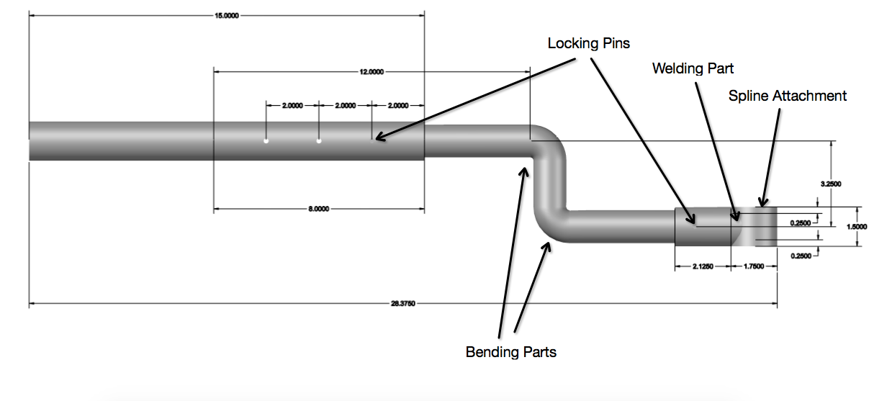
Design Justifications - Dimensions of Lever System

Slide 48
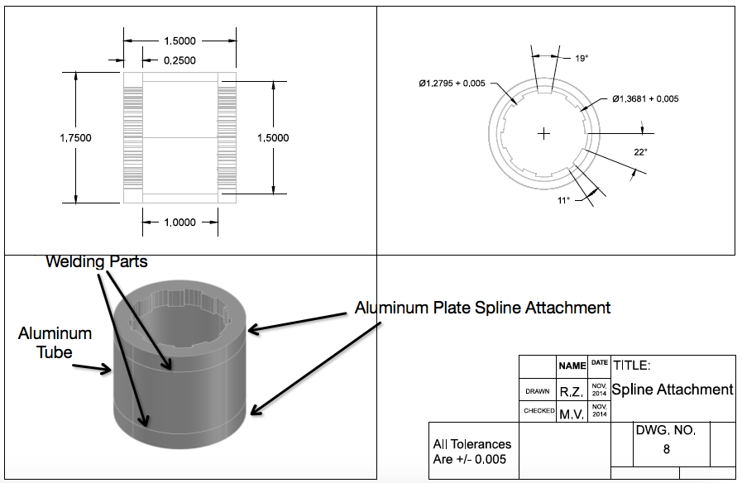
Design Justifications - Dimensions of Lever System

Slide 49
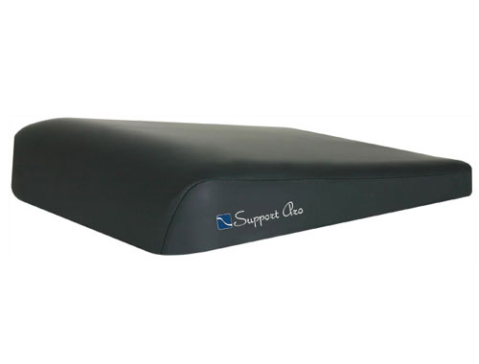
Wedged Cushion
Waterfall front surface eliminates pressure points
Coccyx relief Area
Fabric designed for pressure relief
Fluid proof and anti-microbial fabric
300lb weight capacity
(from 1800wheelchair.ca)

Slide 50
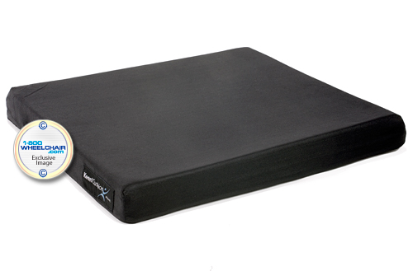
Flat Cushion
Two layers of foam
  Top layer is a memory foam like material
  Lower layer is a high resiliency material to reduce the risk of bottoming out
Water resistant, washable cover
Weight capacity of 250lbs
(from 1800wheelchair.ca)

Slide 51
Cushion Deflections
Used estimated indentation load deflection (ILD) values
  The higher the ILD the firmer the foam
Estimated upper foam to have a 25 ILD rating and lower foam to have a 40 ILD rating
Utilized acceleration data collected during testing (19.5m/s²)
A 250lb rider will experience about 1.5” of displacement at maximum acceleration
A 175lb rider will experience about 1.0” of displacement

Slide 52
Final AHP Weightings
Criterion | Assistant comfort | Adjustability for assistants | Assistant energy conservation | Durability | Maintenance | Cost | Shock experienced by rider | Rider comfort | Rider adjustability | Degree of rider interaction | Breaking power | Total weight | Row Total | Weighting | Weighting (%) | Weighting Rounded (%)
Assistant comfort | 0.0217 | 0.0072 | 0.01 | 0.0238 | 0.0131 | 0.0544 | 0.0126 | 0.0238 | 0.018 | 0.0082 | 0.0319 | 0.0195 | 0.2443 | 0.0204 | 2.0355 | 2
Adjustability for assistants | 0.1087 | 0.0361 | 0.0232 | 0.0397 | 0.0184 | 0.0544 | 0.0075 | 0.0238 | 0.054 | 0.123 | 0.0319 | 0.1758 | 0.6964 | 0.058 | 5.8035 | 6
Assistant energy conservation | 0.1522 | 0.1082 | 0.0697 | 0.0397 | 0.0919 | 0.0544 | 0.0377 | 0.0714 | 0.1619 | 0.123 | 0.0957 | 0.0586 | 1.0644 | 0.0887 | 8.8698 | 9
Durability | 0.1087 | 0.1082 | 0.2092 | 0.119 | 0.0919 | 0.0907 | 0.1131 | 0.2143 | 0.1619 | 0.123 | 0.0957 | 0.0586 | 1.4942 | 0.1245 | 12.4517 | 12
Maintenance | 0.1522 | 0.1803 | 0.0697 | 0.119 | 0.0919 | 0.0907 | 0.1131 | 0.2143 | 0.018 | 0.123 | 0.0957 | 0.1758 | 1.4437 | 0.1203 | 12.0305 | 12
Cost | 0.1087 | 0.1803 | 0.3486 | 0.3571 | 0.2758 | 0.272 | 0.1884 | 0.2143 | 0.2698 | 0.1721 | 0.1596 | 0.1758 | 2.7226 | 0.2269 | 22.6882 | 23
Shock experienced by rider | 0.0652 | 0.1803 | 0.0697 | 0.0397 | 0.0306 | 0.0544 | 0.0377 | 0.0238 | 0.018 | 0.0082 | 0.0319 | 0.0195 | 0.5791 | 0.0483 | 4.8257 | 5
Rider comfort | 0.0652 | 0.1082 | 0.0697 | 0.0397 | 0.0306 | 0.0907 | 0.1131 | 0.0714 | 0.1619 | 0.0246 | 0.0957 | 0.1758 | 1.0466 | 0.0872 | 8.7216 | 9
Rider adjustability | 0.0652 | 0.0361 | 0.0232 | 0.0397 | 0.2758 | 0.0544 | 0.1131 | 0.0238 | 0.054 | 0.0738 | 0.1596 | 0.0586 | 0.9772 | 0.0814 | 8.1434 | 8
Degree of rider interaction | 0.0652 | 0.0072 | 0.0139 | 0.0238 | 0.0184 | 0.0389 | 0.1131 | 0.0714 | 0.018 | 0.0246 | 0.0106 | 0.0117 | 0.4169 | 0.0347 | 3.4738 | 3
Breaking power | 0.0217 | 0.0361 | 0.0232 | 0.0397 | 0.0306 | 0.0544 | 0.0377 | 0.0238 | 0.0108 | 0.0738 | 0.0319 | 0.0117 | 0.3955 | 0.033 | 3.2955 | 3
Total weight | 0.0652 | 0.012 | 0.0697 | 0.119 | 0.0306 | 0.0907 | 0.1131 | 0.0238 | 0.054 | 0.123 | 0.1596 | 0.0586 | 0.9193 | 0.0766 | 7.6606 | 8
Total | 1 | 1 | 1 | 1 | 1 | 1 | 1 | 1 | 1 | 1 | 1 | 1 | 12 | 1 | 100 | 100

Slide 53
Cost Breakdown per TrailRider
Cost Category | Cost
Implementation Prototyping Further Development | $1,339.68
Manufacturing and Assembly | $2,892.89
Lifetime Operating Maintenance Disposal | $1,942.84
Cost of Goods | $2,564.91
Total Lifetime Cost | $7,400.64

Slide 54
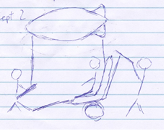
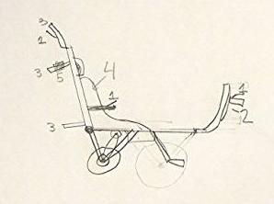
Alternate Concepts (Initial)
Concept 3
  Blimp provides upwards force
Concept 4
  Electric motor
  Hand brakes at three locations

Slide 55
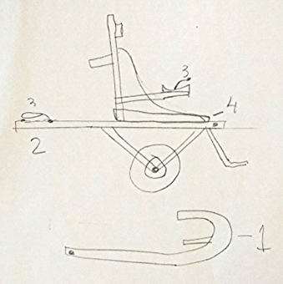
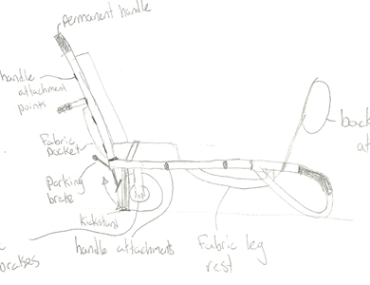
Alternate Concepts (Initial)
Concept 5
  Sliding seat to allow for option of one or two assistants
Concept 6
  Backpack harness
  Disc brakes
  Spring dampers

Slide 56
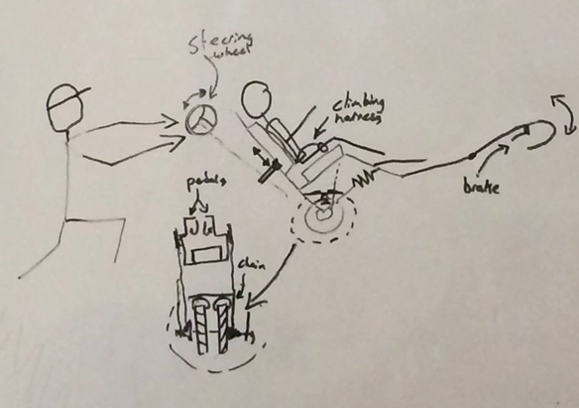
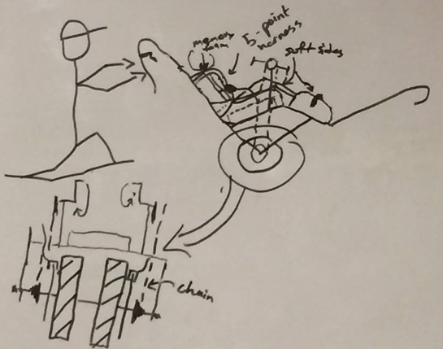
Alternate Concepts (WDM)
Concept 1
  Dual wheels
  Rider operated pedal power assist
  Climbing harness for rider
Concept 2
  Rider operated pedal power assist
  5-point harness for rider
  Dual wheels

Slide 57
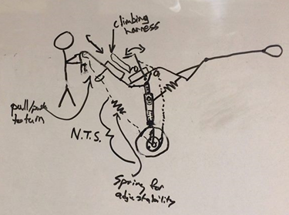
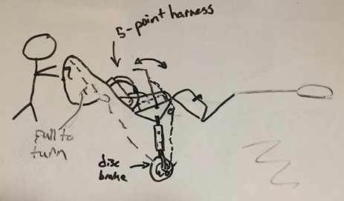
Alternate Concepts (WDM)
Concept 3
  Single wheel
  Climbing harness for rider
  Lever operated by rider for power assist
Concept 4
  Single wheel
  5-point harness for rider
  Lever operated by rider for power assist

